Slide 1
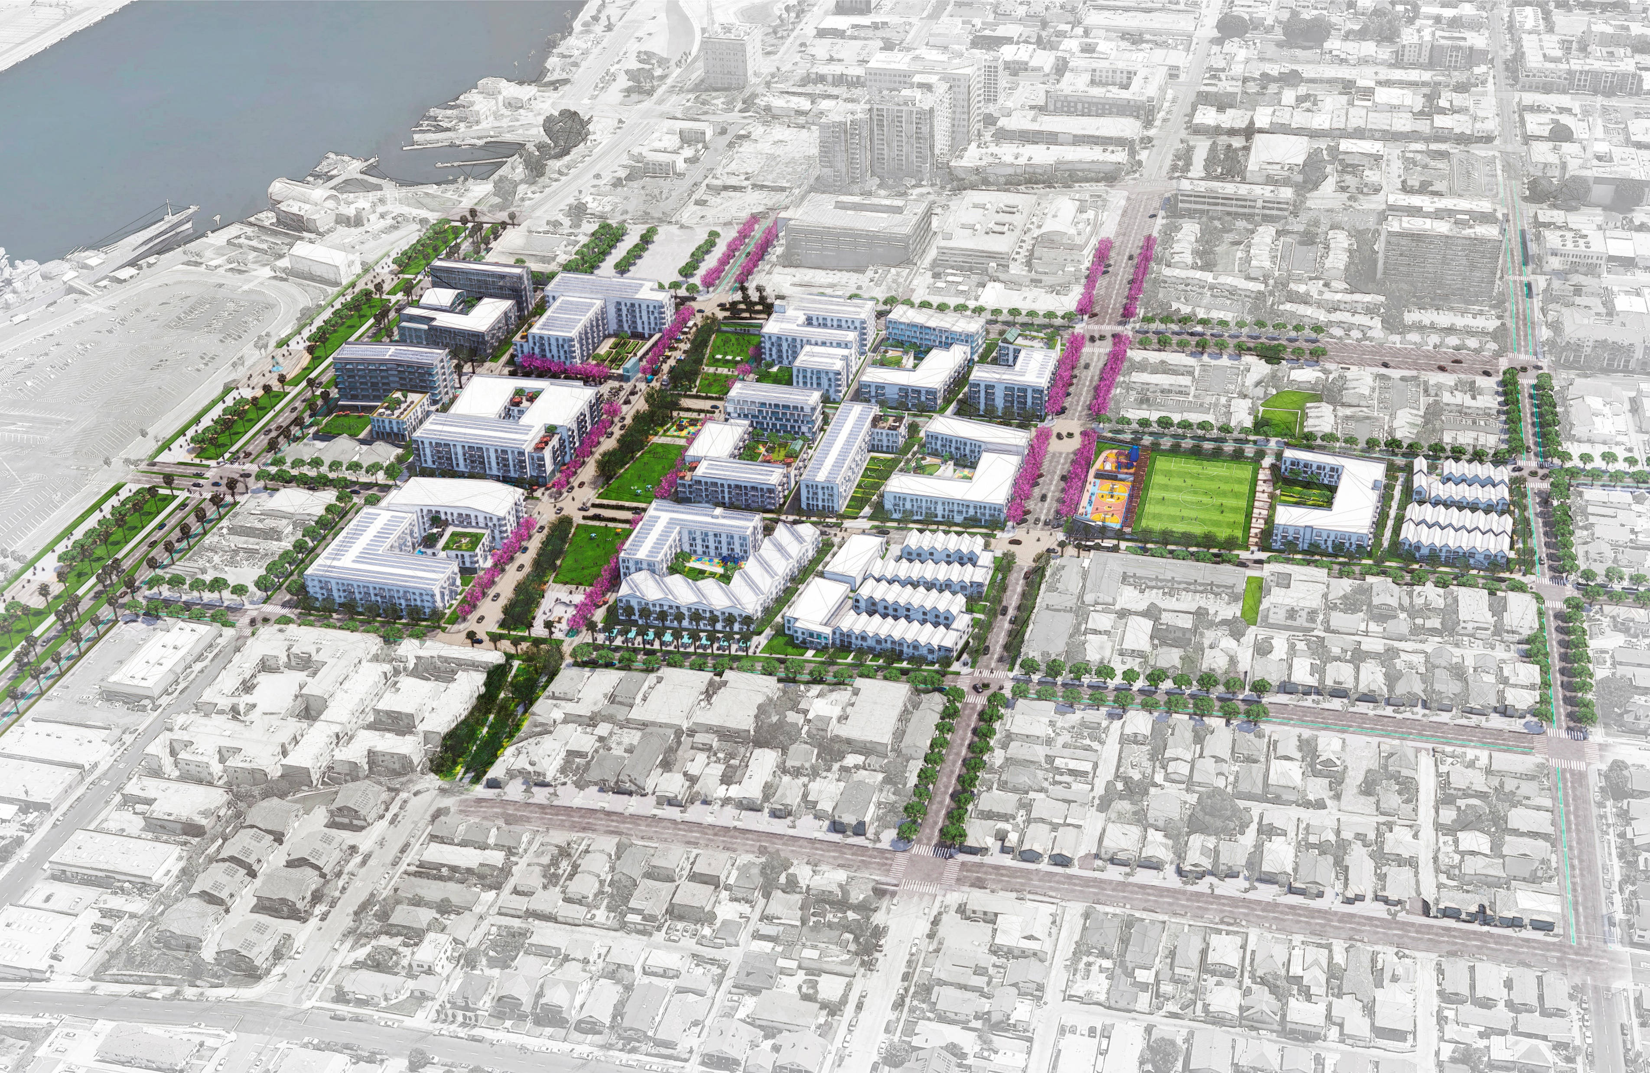
Housing Authority of the City of Los Angeles &
Los Angeles Housing Department
One San Pedro Draft Environmental Impact Report/Environmental Impact Statement
Public Meeting / June 28, 2023

Slide 2
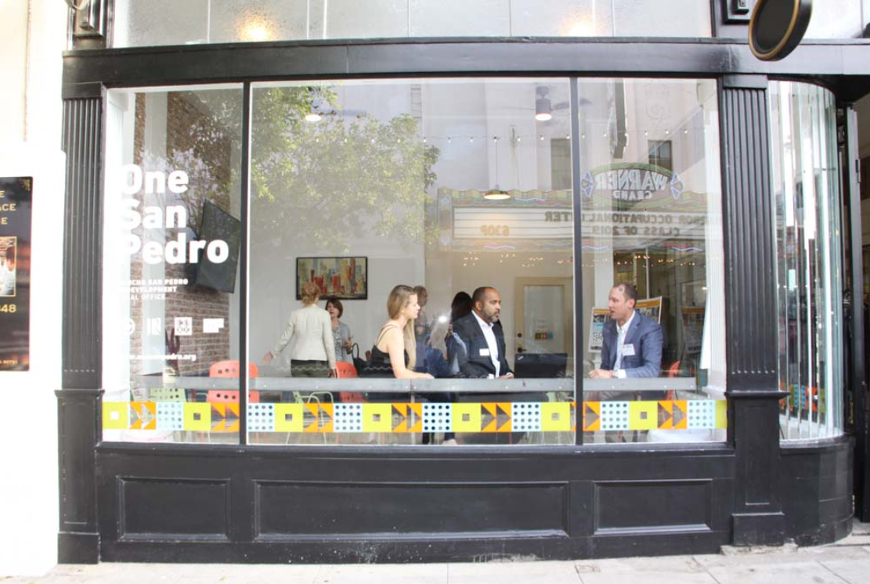
Meeting Agenda
Purpose of the Public Meeting
Project Overview
Environmental Review Process
Results of the Draft Environmental Impact Report (EIR)/Environmental Impact Statement (EIS)
Comments/Input
Above: Scene from the grand opening of the One San Pedro office in downtown San Pedro in June 2019.
6/28/2023
One San Pedro Draft EIR/EIS Public Meeting
2

Slide 3
Purpose of the Public Meeting
Inform the community and affected agencies about the project
Describe additional opportunities for community input
Gather input from stakeholders about the Draft EIR/EIS
6/28/2023
One San Pedro Draft EIR/EIS Public Meeting

Slide 4
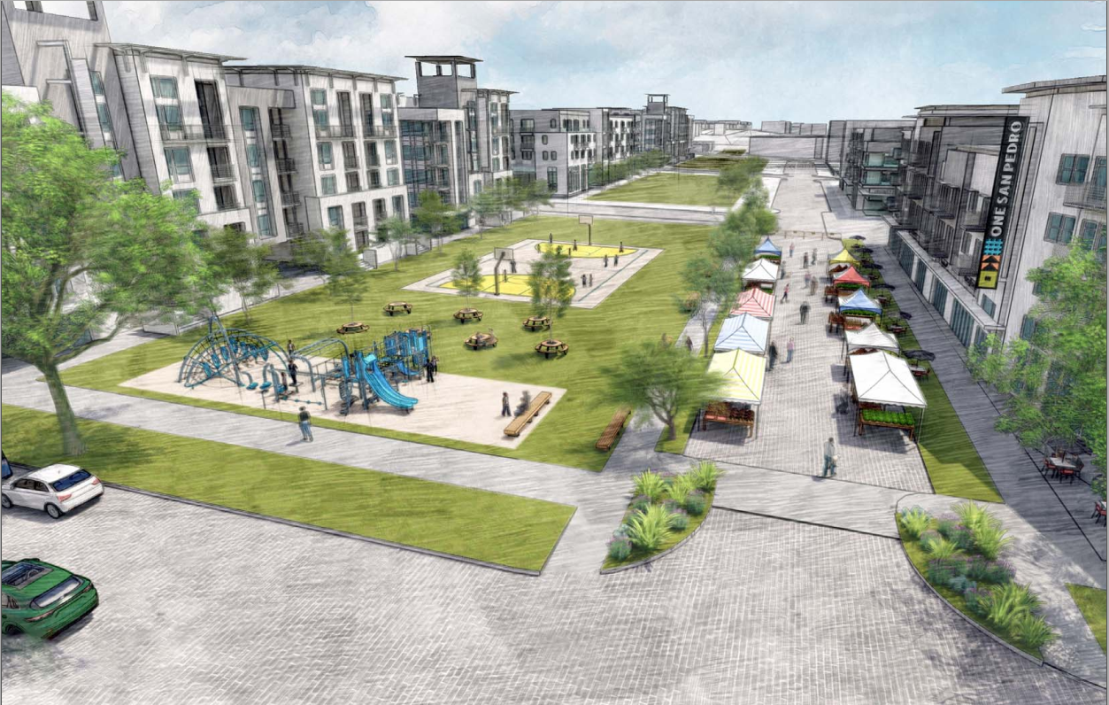
Environmental Review Process

Slide 5
CEQA and NEPA
Two types of environmental review conducted: California Environmental Quality Act (CEQA) and National Environmental Policy Act (NEPA)
Require public agencies to consider environmental consequences of discretionary actions before approving plans, policies, or projects.
Disclose project impacts to public and decision makers.
Foster interagency coordination and review.
Identify ways to avoid or reduce environmental impacts.
6/28/2023
One San Pedro Draft EIR/EIS Public Meeting
5
Notes:
California Environmental Quality Act (CEQA) - Statewide environmental disclosure law. Required because the project would need discretionary approvals from HACLA and the City of Los Angeles, including but not limited to approval of the Specific Plan, a zone change, and General Plan Amendment
National Environmental Policy Act (NEPA) - U.S. environmental disclosure law. Required because the project involves Federal funding from the United States Department of Housing and Urban Development (HUD)

Slide 6
Environmental Review Timeline
Public Input Opportunities
We are
here
Prepare/Distribute Notice of Preparation and Notice of Intent (minimum 30 days)
January 13, 2021–
May 10, 2021
Notice of Availability
Public and Agency Review of Draft EIR/EIS (minimum 45 days)
June 23, 2023 –
August 21, 2023
Release Final EIR/EIS 10 days in advance to Board Action
Fall 2023
File Notice of Determination within
5 business days
Fall-Winter 2023
Prepare Draft EIR/EIS
October 2021 –
June 2023
HACLA and LAHD Governing Board Meetings
Fall-Winter 2023
Prepare Final EIR/EIS including Response to Comments
August 2023 – September 2023
6/28/2023
One San Pedro Draft EIR/EIS Public Meeting

Slide 7
How to view the Draft EIR/EIS
Online:
https://www.hacla.org/en/about-us/public-documents
https://housing.lacity.org/partners/nepa-review
Hard Copies:
Rancho San Pedro Property Management Office, 275 West 1st Street (Monday – Friday: 8:30 a.m. – 4:00 p.m.)
San Pedro Regional Branch Library, 931 South Gaffey Street (Monday – Thursday: 10:00 a.m. – 8:00 p.m., Friday and Saturday: 9:30 a.m. to 5:30 p.m., Sunday: 1:00 p.m. to 5:00 p.m.)
City of Los Angeles Council District 15 San Pedro Office, 638 South Beacon Street, Room 552 (Monday – Friday: 9:00 a.m. – 5:00 p.m.)
One San Pedro Draft EIR/EIS Public Meeting

Slide 8
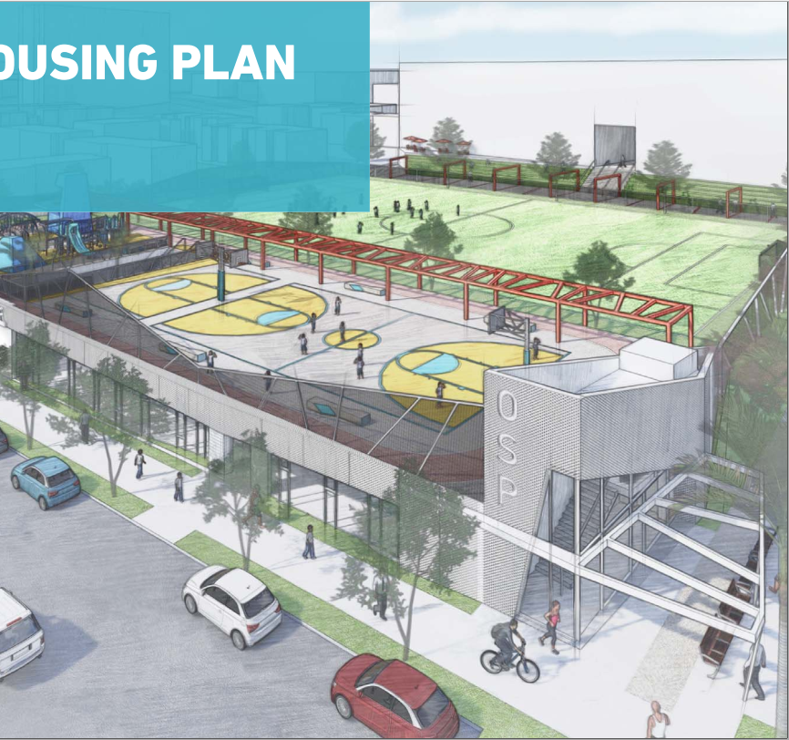
Project Overview

Slide 9
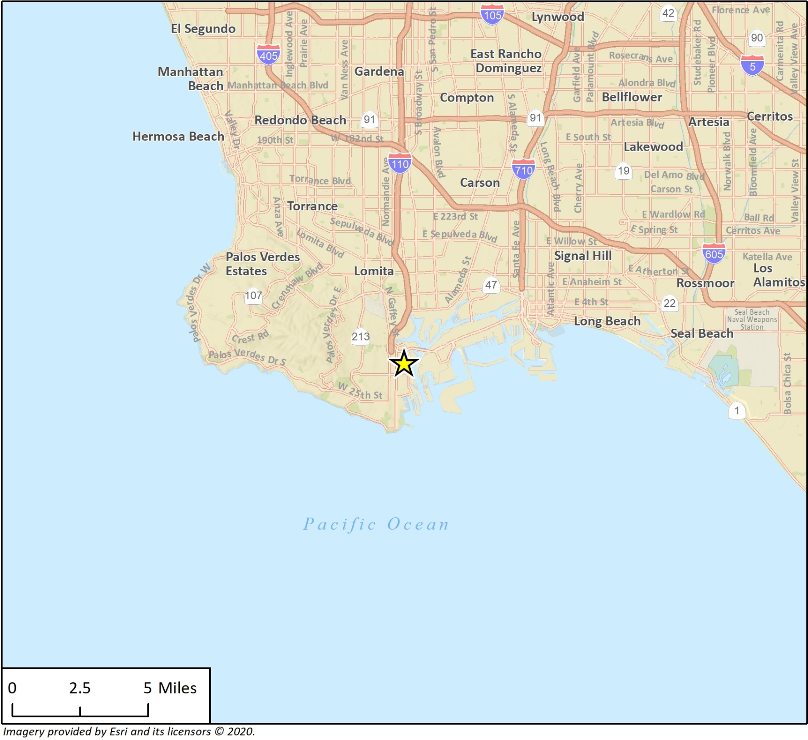
Project Location
6/28/2023
One San Pedro Draft EIR/EIS Public Meeting
9

Slide 10
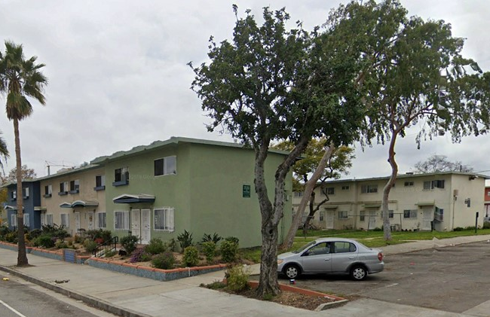
Project Site
Above: Streetview of Rancho San Pedro.
Above: Streetview of the 327 Harbor Site.
6/28/2023
One San Pedro Draft EIR/EIS Public Meeting
10

Slide 11
One San Pedro Project Purpose
Purpose: Improve the physical condition of the Rancho San Pedro community and increase housing stock and amenities for residents.
Benefits:
Improve housing conditions for existing residents
Increase affordable and senior housing availability
Expand community amenities and open space
Improve multi-modal mobility facilities
Create a vibrant, mixed-use community
6/28/2023
One San Pedro Draft EIR/EIS Public Meeting
11

Slide 12
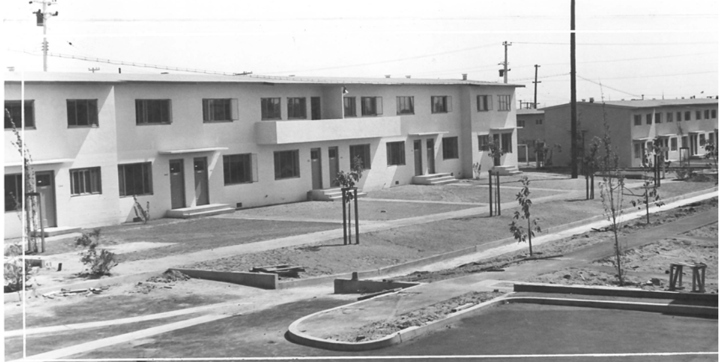
Project Components
Phased demolition of Rancho San Pedro and replacement with new housing, local-serving commercial uses, and amenities.
New housing at 327 Harbor Site.
Development Summary table:
Land Uses | OSP Site | 327 Harbor Site
Residential (units) | 1,553 | 47
Commercial/Retail (sq. ft.) | 45,000 | 0
Neighborhood Serving Uses (sq. ft.) | 85,000 | 0
Open Space | 10.3 acres | 7,006 sq. ft.
Above: Historic picture of Rancho San Pedro after it was constructed in 1942.
6/28/2023
One San Pedro Draft EIR/EIS Public Meeting
12

Slide 13
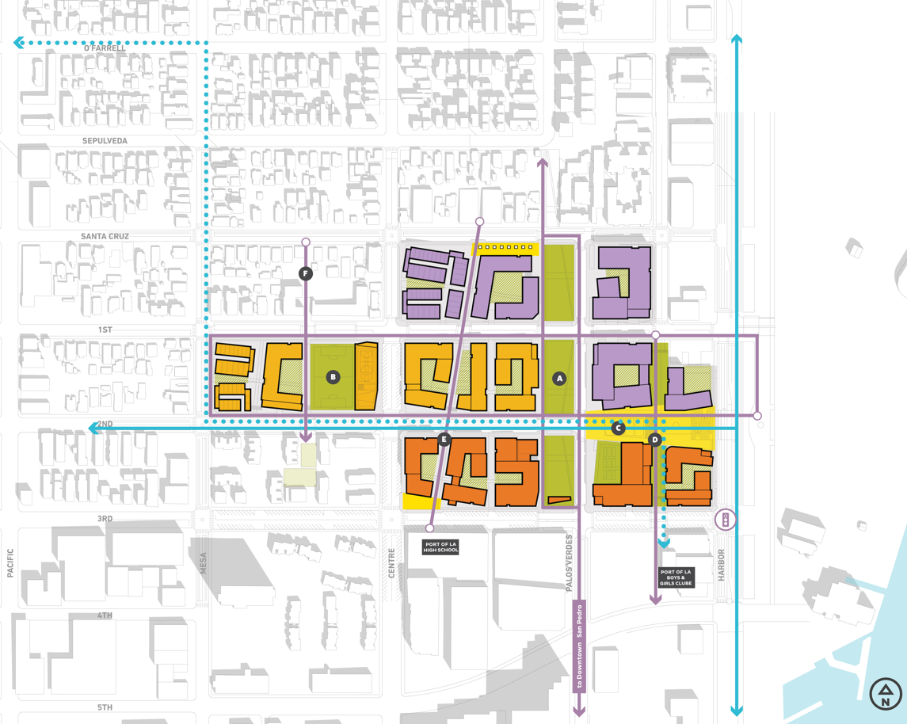
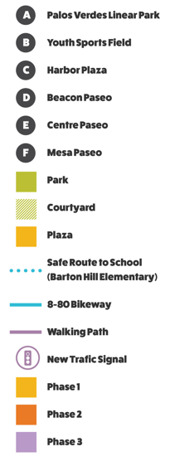
Conceptual Site Plan

Slide 14
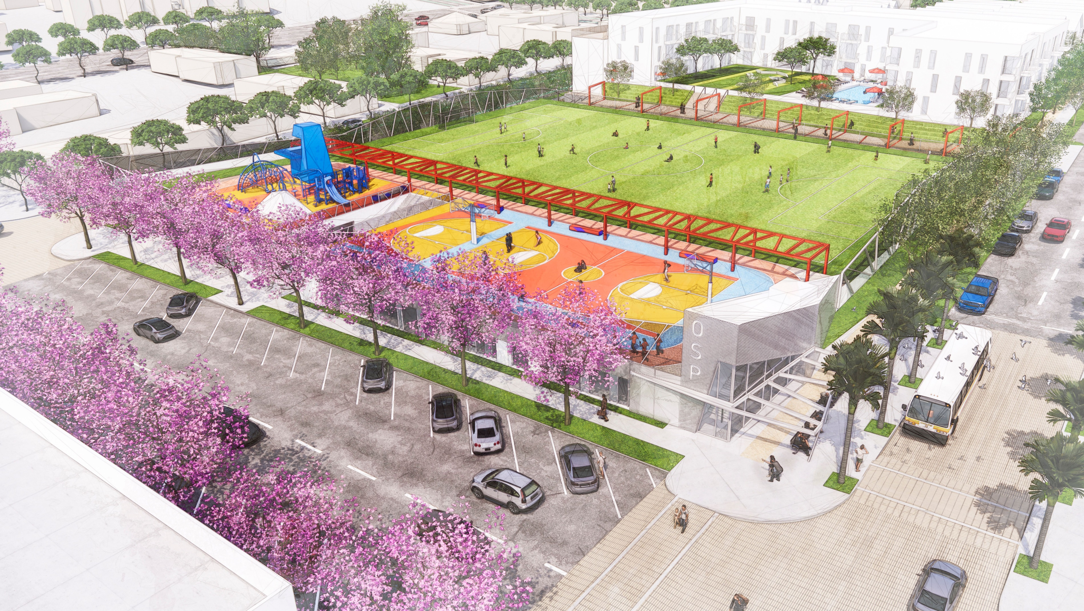
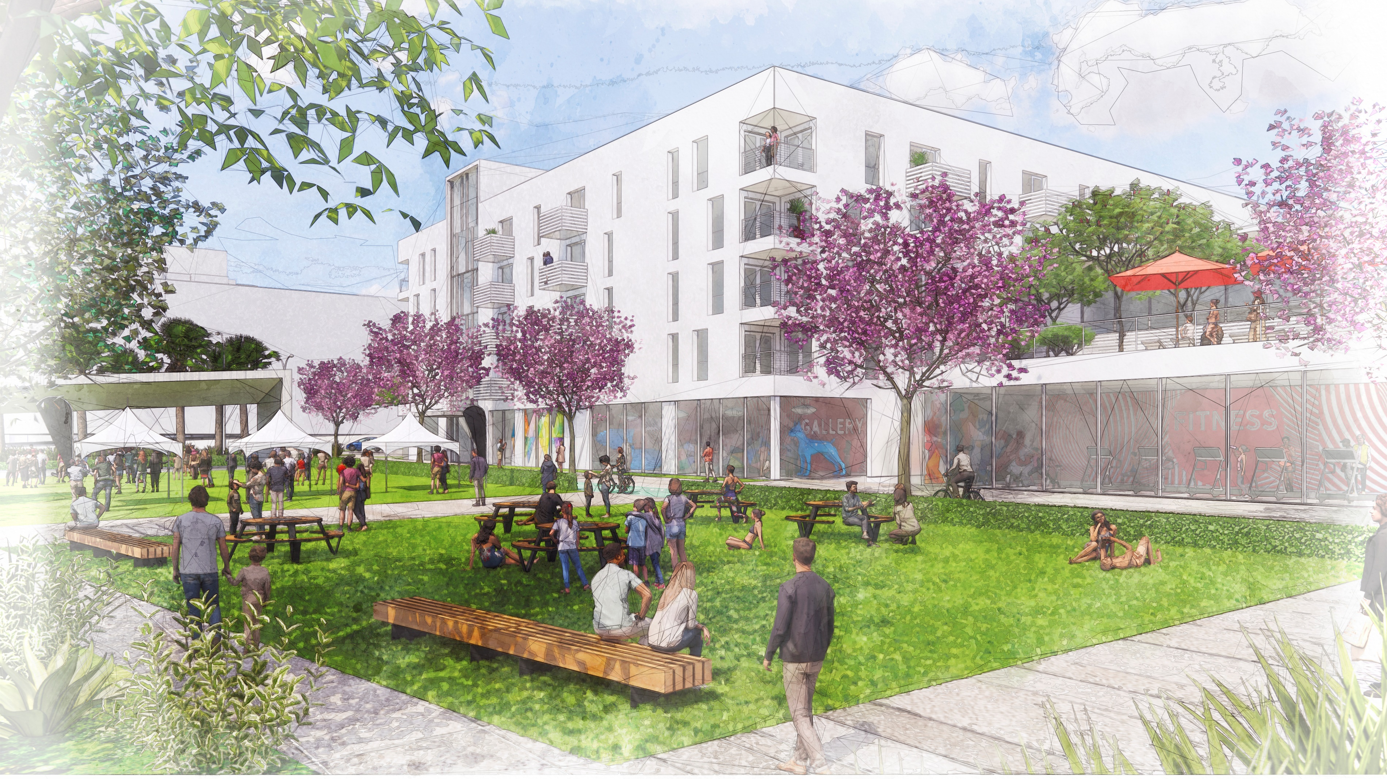
Open Space Renderings

Slide 15
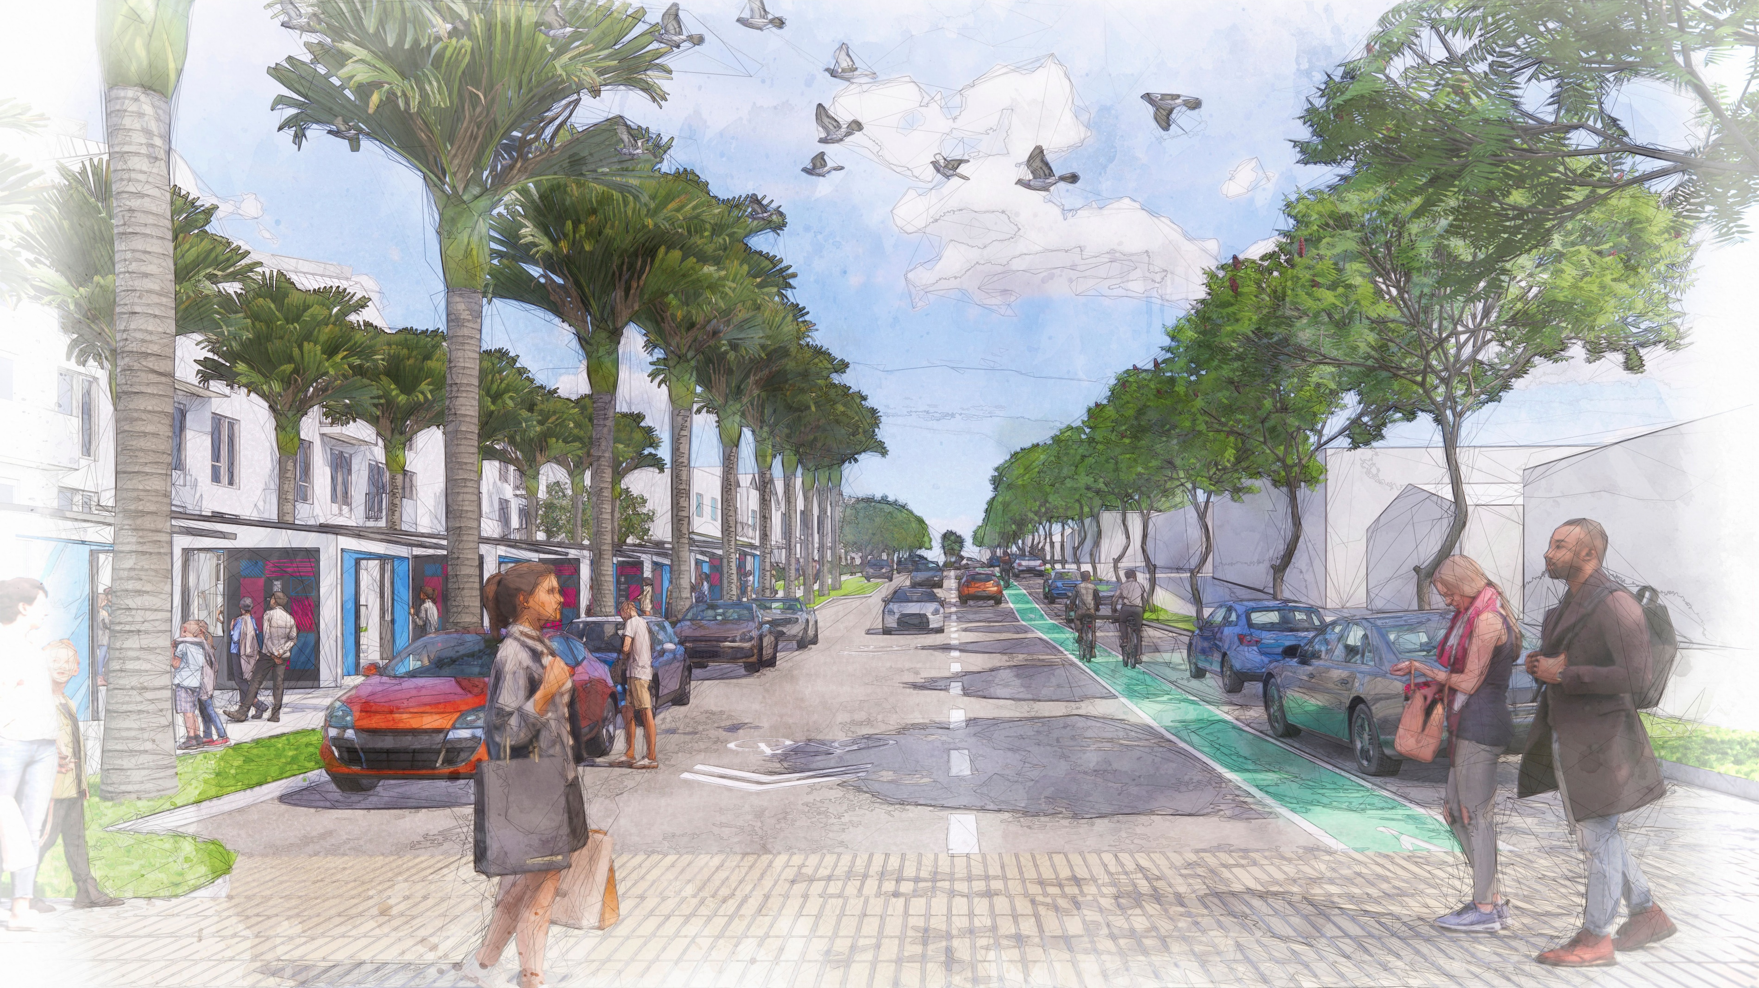
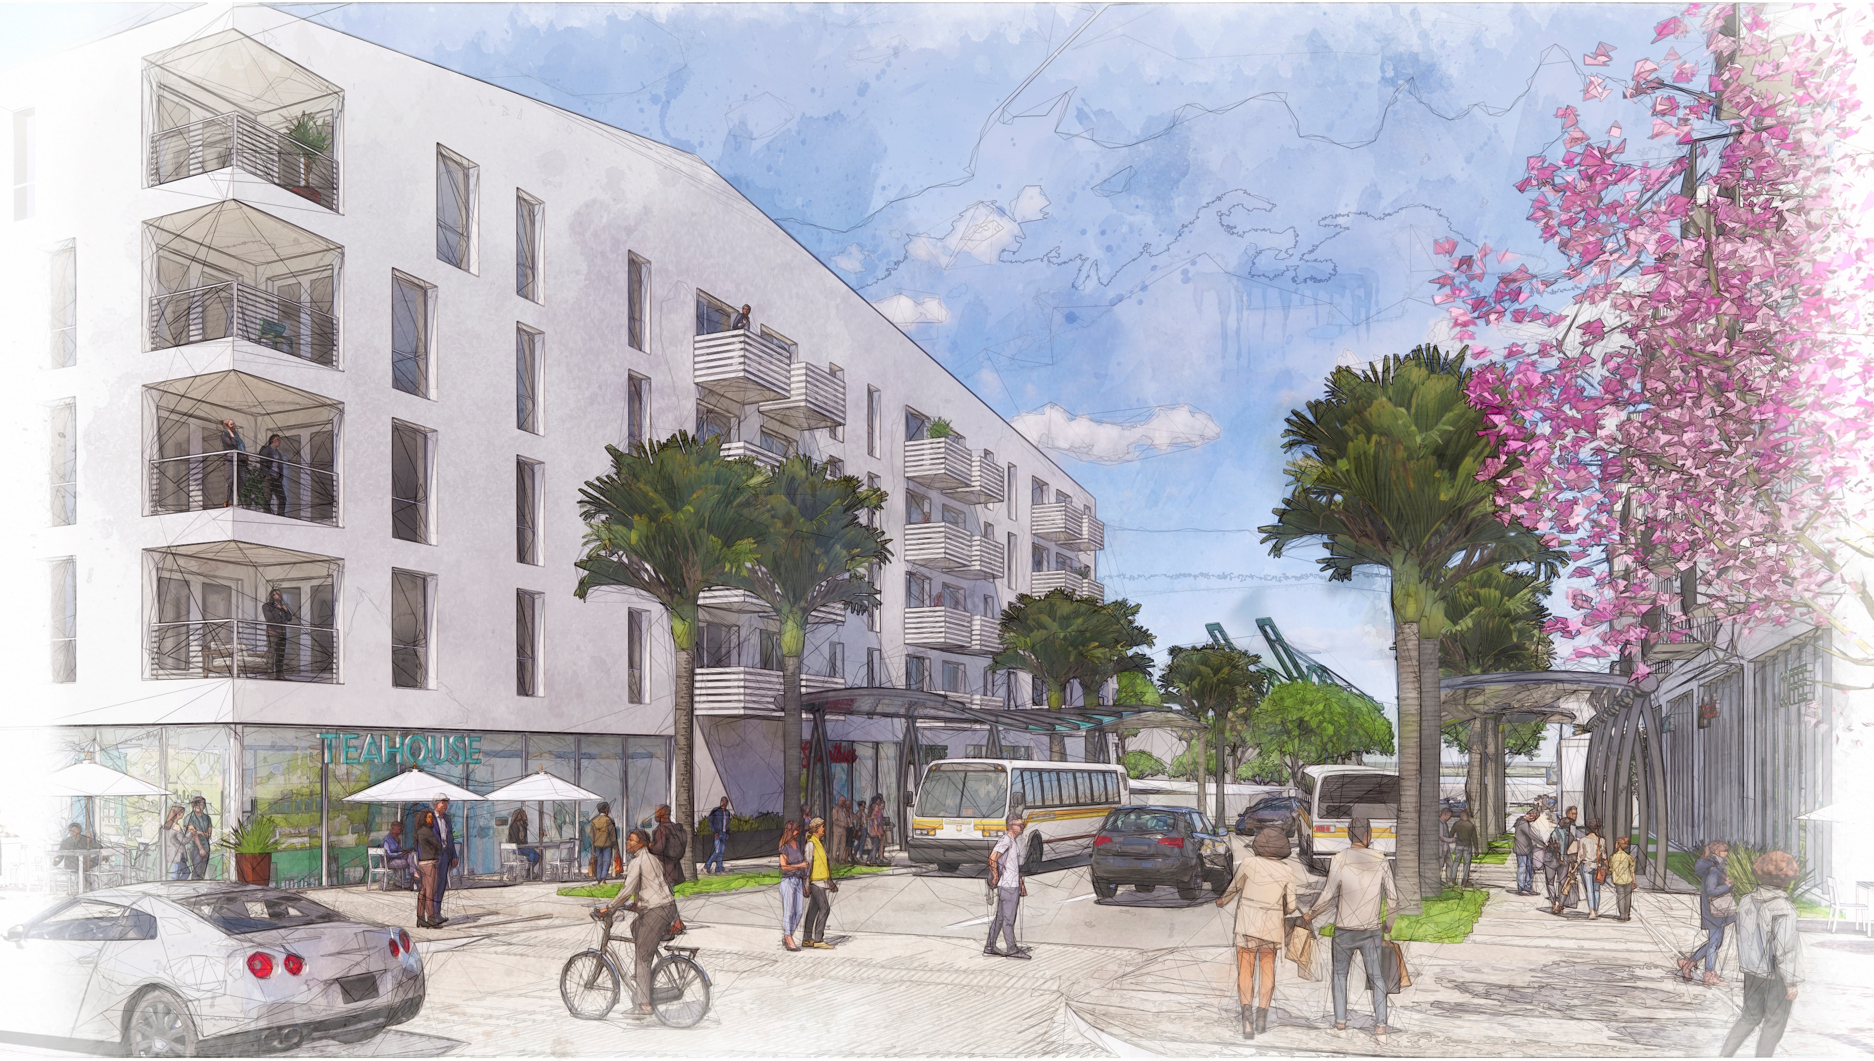
Mobility Renderings

Slide 16
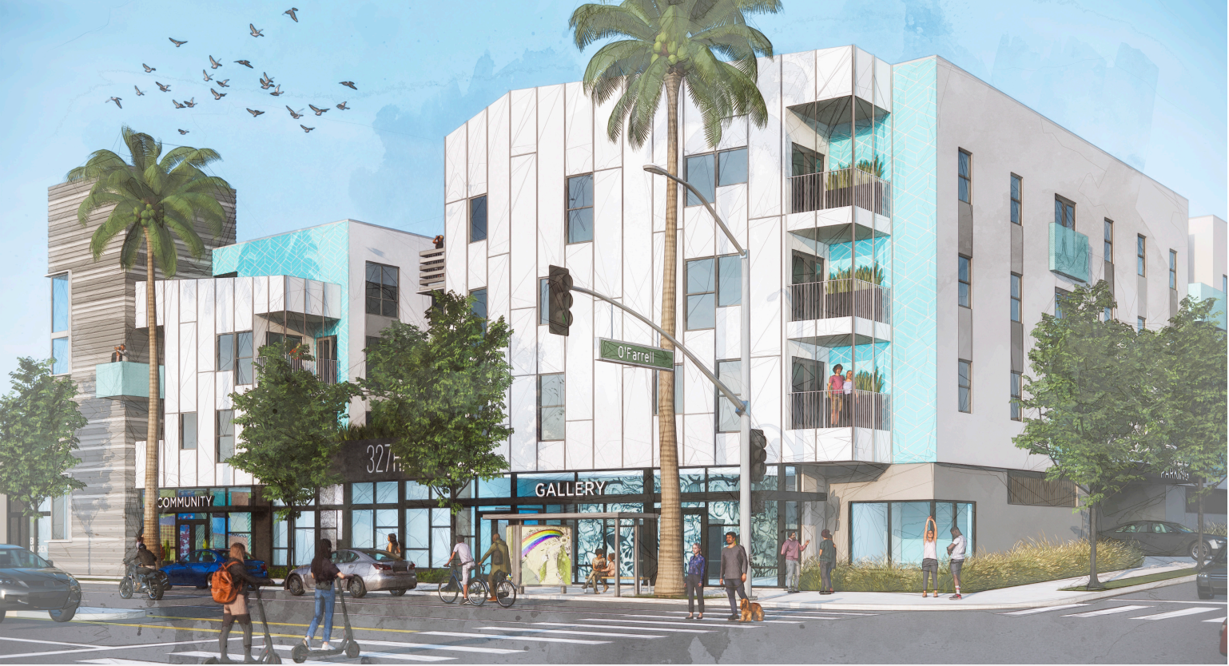
327 Harbor Site Rendering

Slide 17
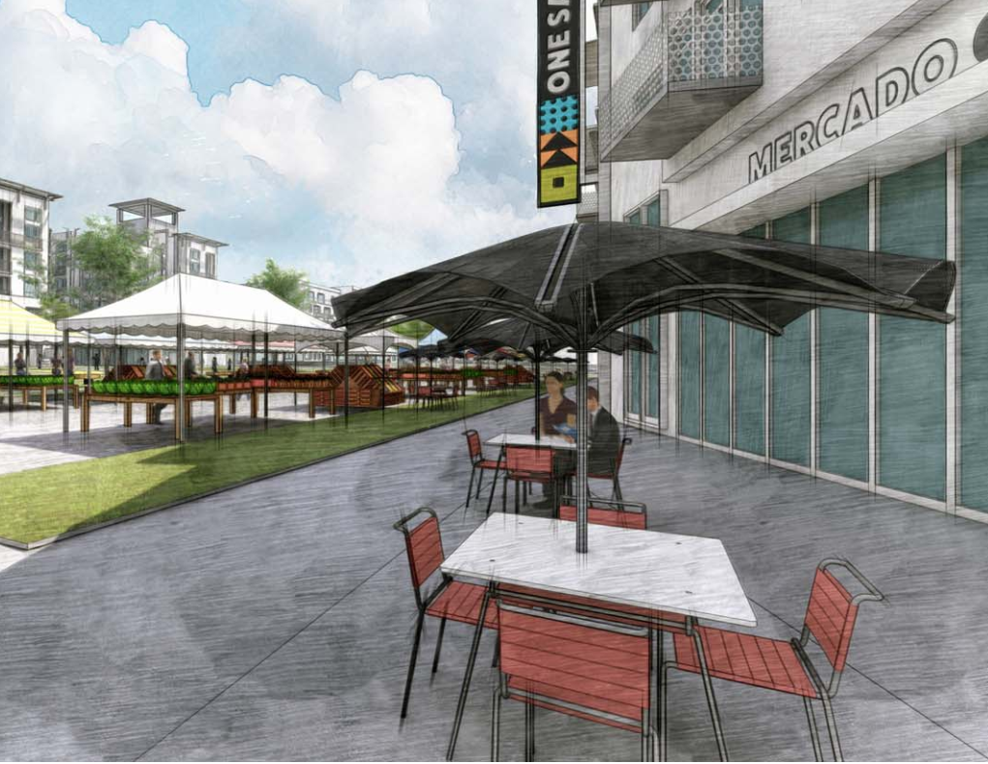
Draft EIR/EIS Findings

Slide 18
Environmental Topics Analyzed in the EIR/EIS
Color Key
No impact/less than significant impact
Mitigation measures reduce impact
Significant and unavoidable impact
Aesthetics Agriculture/Forestry Air Quality Biological Resources Cultural Resources Energy Environmental Justice and Socioeconomics Geology/Soils Greenhouse Gas Emissions/Climate Change
Hazards/Hazardous Materials Hydrology/Water Quality Land Use/Planning Noise Population/Housing Public Services Recreation Transportation Tribal Cultural Resources Utilities/Service Systems
Lowest
impact
Greatest
impact
6/28/2023
One San Pedro Draft EIR/EIS Public Meeting
18
Notes:
These are the environmental topics that were analyzed in the EIR/EIS. The project was found to have no impact or a less than significant impact to the topics shown in black text, a less than significant impact with mitigation incorporated to the topics shown in orange text, and a significant and unavoidable impact to the topics shown in red text.

Slide 19
Section 4.1 — Aesthetics
Potential CEQA and NEPA impacts to visual quality and light and glare during construction reduced to less than significant level with Mitigation Measures: AES-1 Construction Screening: Temporary construction fencing shall be placed along the periphery of active construction staging and work areas to shield construction activity from view at the street level. AES-2 Construction Lighting: Outdoor lighting used during construction shall be shielded and/or aimed such that the light source cannot be seen from adjacent residential properties and the public right-of-way. However, construction lighting shall be sufficient to protect the safety of construction workers.
6/28/2023
One San Pedro Draft EIR/EIS Public Meeting
19

Slide 20
Section 4.2 — Air Quality
Potential CEQA impacts to air quality during construction and operation reduced to less than significant level with Mitigation Measures: AQ-1 Construction Equipment: Construction equipment shall meet the U.S. EPA Tier 4 final standards or be electric. AQ-2 Landscaping Equipment Electrification: The project shall include a minimum of 25 percent electric landscaping equipment use in all contracts for landscaping services to be rendered on site.
6/28/2023
One San Pedro Draft EIR/EIS Public Meeting
20

Slide 21
Section 4.3 — Cultural Resources: Historical
Significant and unavoidable CEQA and NEPA impacts to historical resources due to demolition of Rancho San Pedro, even with implementation of Mitigation Measures: CUL-1 Interpretive Display: Interpretive display shall be installed onsite explaining the history and significance of Rancho San Pedro and a description of the project which led to the demolition of the historical resource. CUL-2 Informational Website: Webpage shall be developed that is dedicated to the history of Rancho San Pedro, the significance of public housing in the city, and notable examples of public housing architecture and site planning.
Above: Historic picture of Rancho San Pedro after it was constructed in 1942.
6/28/2023
One San Pedro Draft EIR/EIS Public Meeting
21

Slide 22
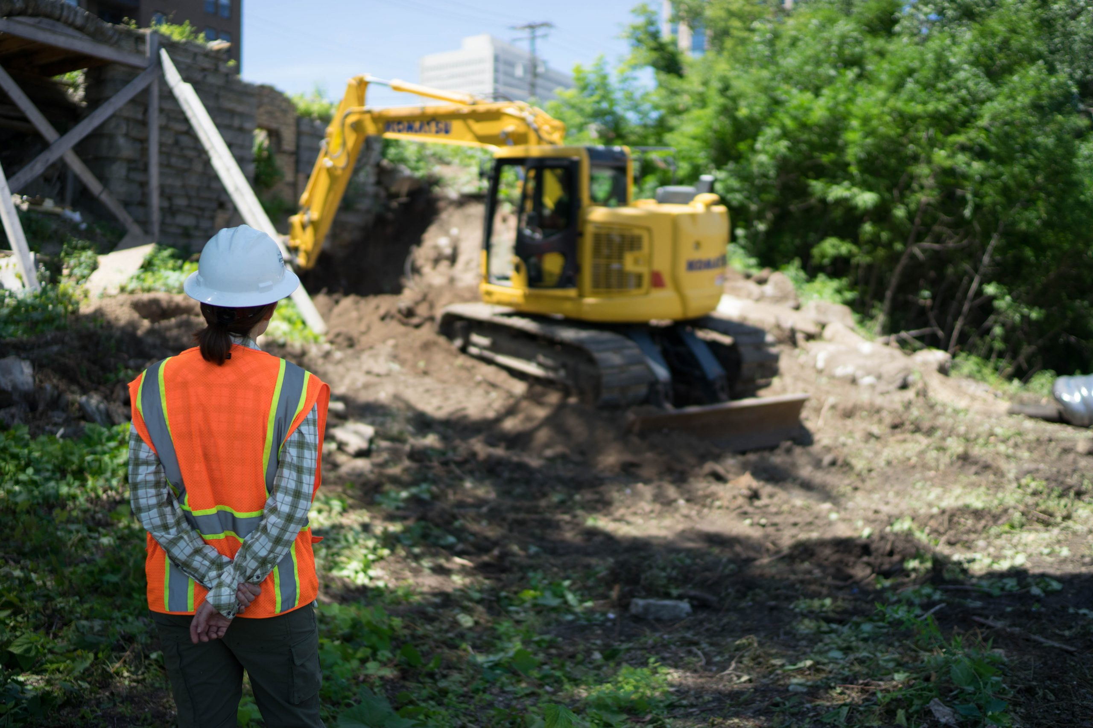
Section 4.3 — Cultural Resources: Archaeological
Potential CEQA impacts to archaeological resources during construction reduced to less than significant level with Mitigation Measures: CUL-3 Project Archaeologist: Professional archaeologist shall be retained to train workers and provide construction monitoring. CUL-4 Worker’s Environmental Awareness Training: Archaeologist shall train construction workers on archaeological sensitivity. CUL-5 Archaeological Monitoring: Archaeologist shall monitor for resources during construction. CUL-6 Inadvertent Discovery of Archaeological Resources: Procedures for treatment shall be implemented per the Archaeologist and Native American monitor’s recommendations. CUL-7 Unanticipated Discovery of Human Remains and Associated Grave Goods: Procedures in accordance with applicable code shall be implemented.
6/28/2023
One San Pedro Draft EIR/EIS Public Meeting
22

Slide 23
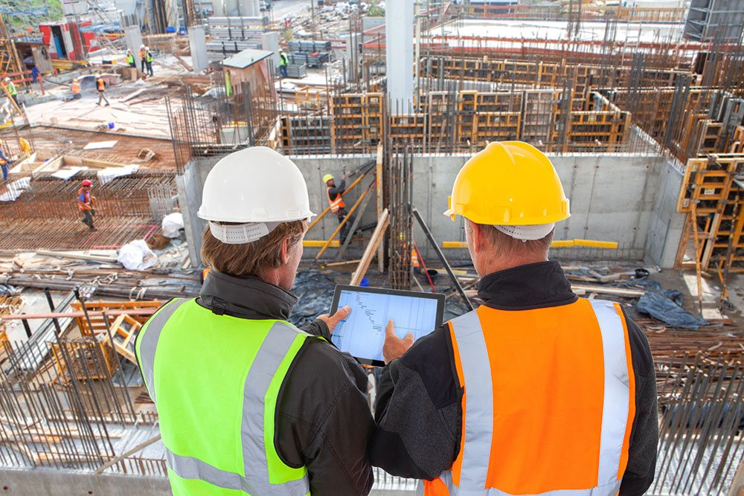
Section 4.4 — Geology and Soils
Potential impacts to geology, soils, and paleontological resources during construction and operation reduced to less than significant level with Mitigation Measures: GEO-1 Final Geotechnical Report: Project shall be constructed in accordance with recommendations of an approved final geotechnical report. GEO-2 Geotechnical Professional Observation: Geotechnical professional shall be retained to observe and test all grading operations for shallow foundations and pile installation. GEO-3 Paleontological Resources Monitoring and Mitigation: Qualified paleontologist shall be retained to monitor for fossils during construction, provide construction worker training, and oversee treatment of fossils if any are discovered.
6/28/2023
One San Pedro Draft EIR/EIS Public Meeting
23

Slide 24
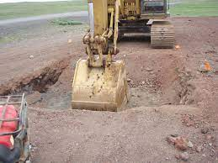
Section 4.6 — Hazards and Hazardous Materials
Potential impacts related to contaminated soils during construction and operation reduced to less than significant level with Mitigation Measures: HAZ-1 Voluntary Oversight Agreement with the Los Angeles County Fire Site Mitigation Unit: On-site remediation activities shall be completed under Fire Department oversight. HAZ-2 Soil Management Plan: Approved soil management plan shall be implemented during construction. HAZ-3 Soil Remediation: Contaminated soils shall be properly remediated and disposed of. HAZ-4 Construction Vapor Monitoring Plan: Approved Vapor Monitoring Plan shall be implemented during construction. HAZ-5 Vapor Mitigation System: If contamination exceeds limits, an approved vapor mitigation system shall be implemented beneath project buildings.
6/28/2023
One San Pedro Draft EIR/EIS Public Meeting
24

Slide 25
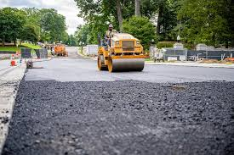
Section 4.9 — Noise and Vibration
Significant and unavoidable CEQA and NEPA impacts related to construction noise and vibration and operational noise, even with implementation of Mitigation Measures: NOI-1 Construction Noise Reduction Measures: Measures such as equipment mufflers and noise barriers shall be implemented. NOI-2 Stationary Recreational Noise Reduction Measures: A PA system design plan shall be implemented to reduce amplified noise. Additional measures such as noise barriers and setbacks at outdoor recreational areas shall be implemented. NOI-3 Construction Vibration Reduction Measures: Alternate equipment shall be used for construction activities occurring within 25 feet of offsite buildings. NOI-4 Interior Noise Reduction Measures: An acoustical study of the design-level site plans for the OSP Specific Plan Site shall be completed and the buildings will be constructed in accordance with the study’s recommendations to reduce interior noise levels.
6/28/2023
One San Pedro Draft EIR/EIS Public Meeting
25

Slide 26
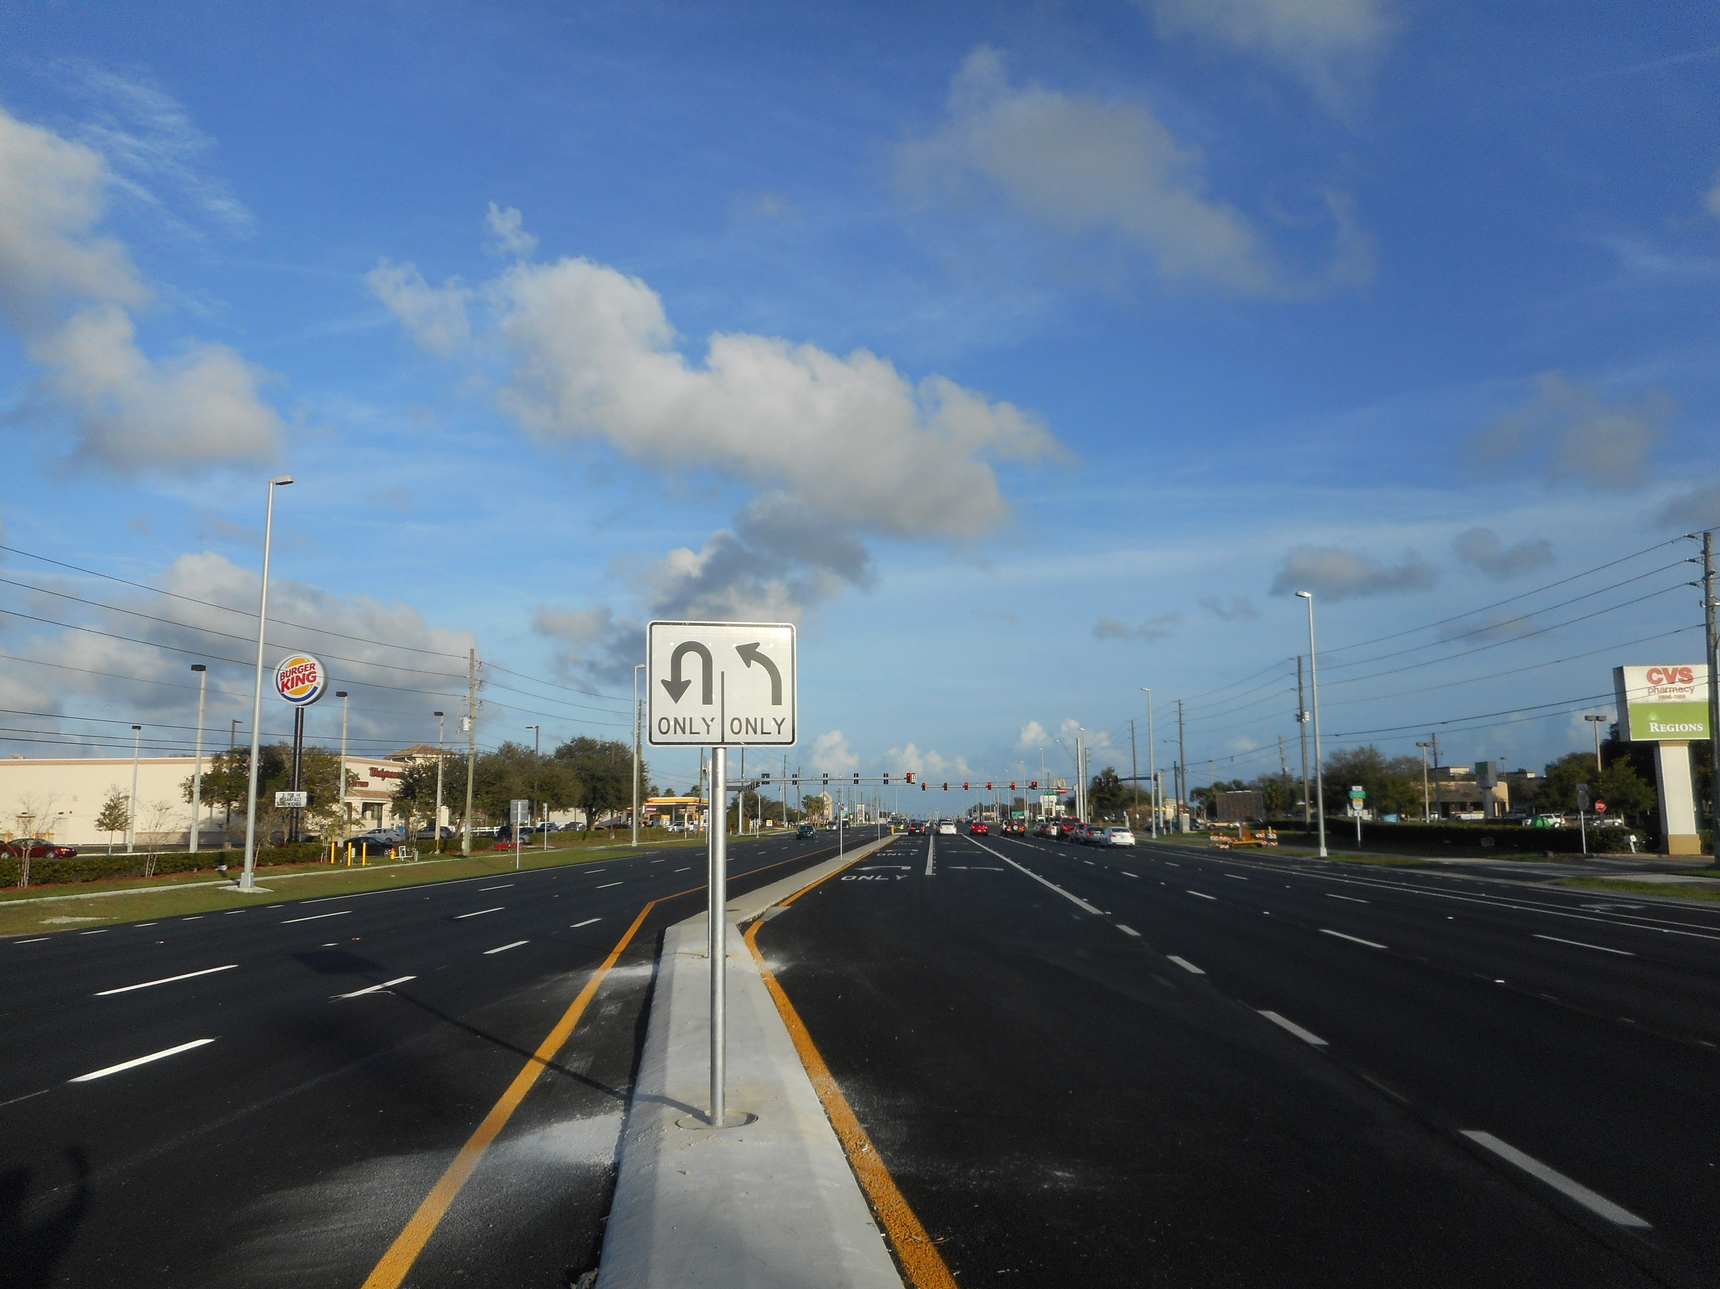
Section 4.13 — Transportation
Potential NEPA impacts to circulation during operation would be less than significant with Mitigation Measure: T-1 Intersection Restriping: Restriping shall be implemented with approval of LADOT to increase turn lane lengths at Gaffey Street and 1st Street, Harbor Boulevard and SR 47 ramps, and Harbor Boulevard and 1st Street.
6/28/2023
One San Pedro Draft EIR/EIS Public Meeting
26

Slide 27
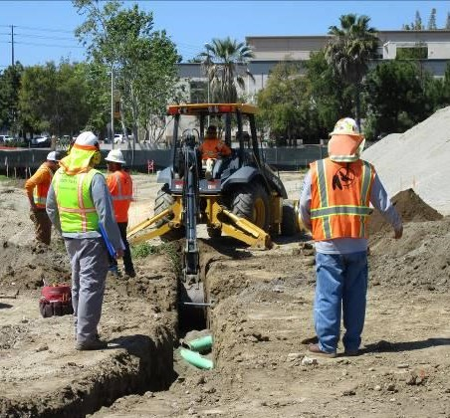
Section 4.14 — Tribal Cultural Resources: Part 1
Potential impacts to Tribal Cultural Resources during construction reduced to less than significant level with Mitigation Measures: TCR-1 Native American Monitoring by the Gabrielino Tongva Indians of California Tribal Council: A Native American monitor representing the Gabrielino Tongva Indians of California Tribal Council shall be invited to monitor during construction. TCR-2 Consultation with the Gabrielino Tongva Indians of California Tribal Council in the Event of Inadvertent Discovery of Tribal Cultural Resources: If TCRs are identified during construction, Native American consultation procedures with the Gabrielino Tongva Indians of California Tribal Council shall be initiated to determine treatment procedures.
6/28/2023
One San Pedro Draft EIR/EIS Public Meeting
27

Slide 28
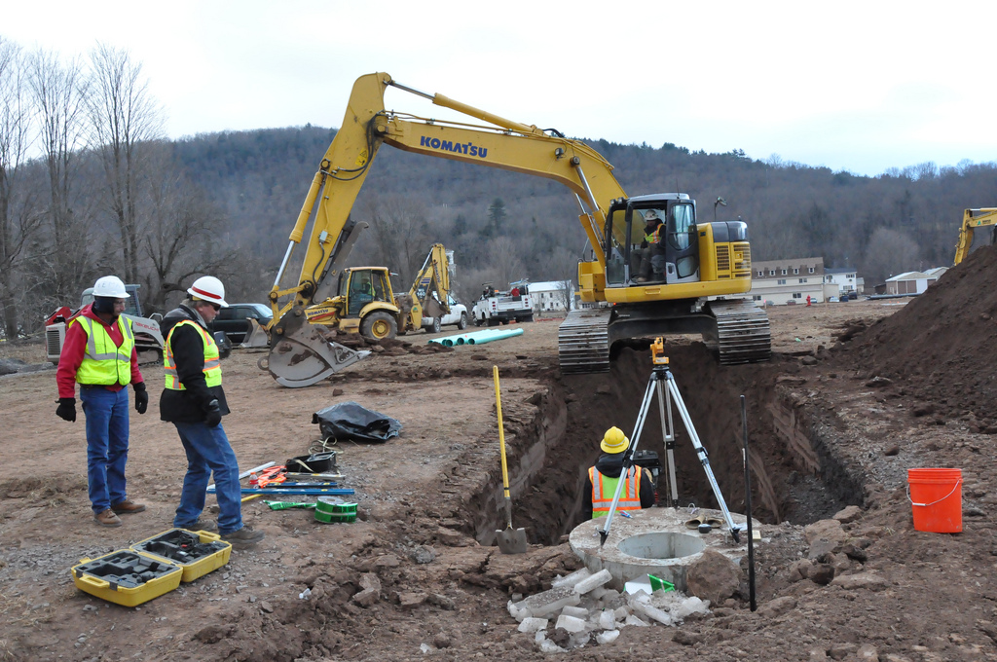
Section 4.14 — Tribal Cultural Resources: Part 2
TCR-3 Native American Monitoring by the Gabrieleño Band of Mission Indians – Kizh Nation: A Native American monitor representing the Gabrieleño Band of Mission Indians – Kizh Nation shall be invited to monitor during construction. TCR-4 Consultation with the Gabrieleño Band of Mission Indians – Kizh Nation in the Event of Inadvertent Discovery of Tribal Cultural Resources: If TCRs are identified during construction, Native American consultation procedures with the Gabrieleño Band of Mission Indians – Kizh Nation shall be initiated to determine treatment procedures. TCR-5 Tribal Cultural Resource Finds Dispute Resolution: In the event that a TCR is identified during monitoring that cannot be directly associated with the Gabrielino Tongva Indians of California Tribal Council or the Gabrieleño Band of Mission Indians – Kizh Nation through analysis, HACLA shall request a consultation meeting with the Gabrielino Tongva Indians of California Tribal Council and the Gabrieleño Band of Mission Indians – Kizh Nation to consult on the disposition of the find(s).
6/28/2023
One San Pedro Draft EIR/EIS Public Meeting
28

Slide 29
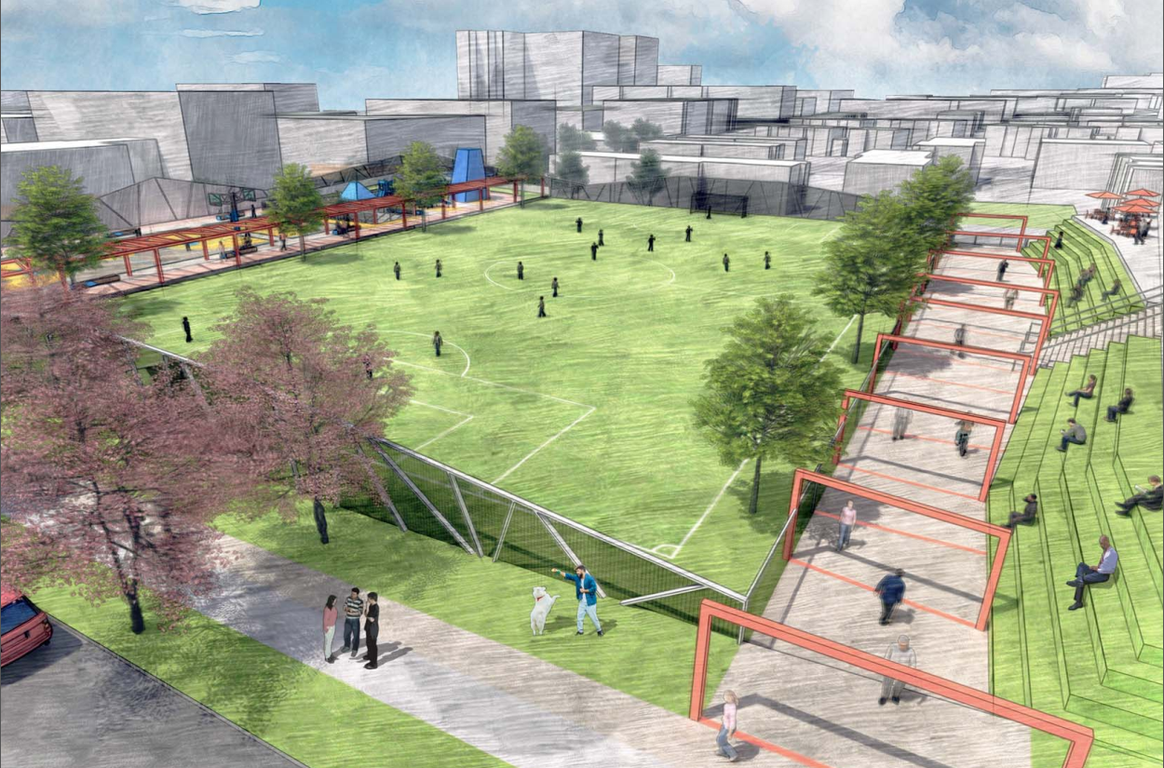
Comments
Comments Regarding the Draft EIR/EIS

Slide 30
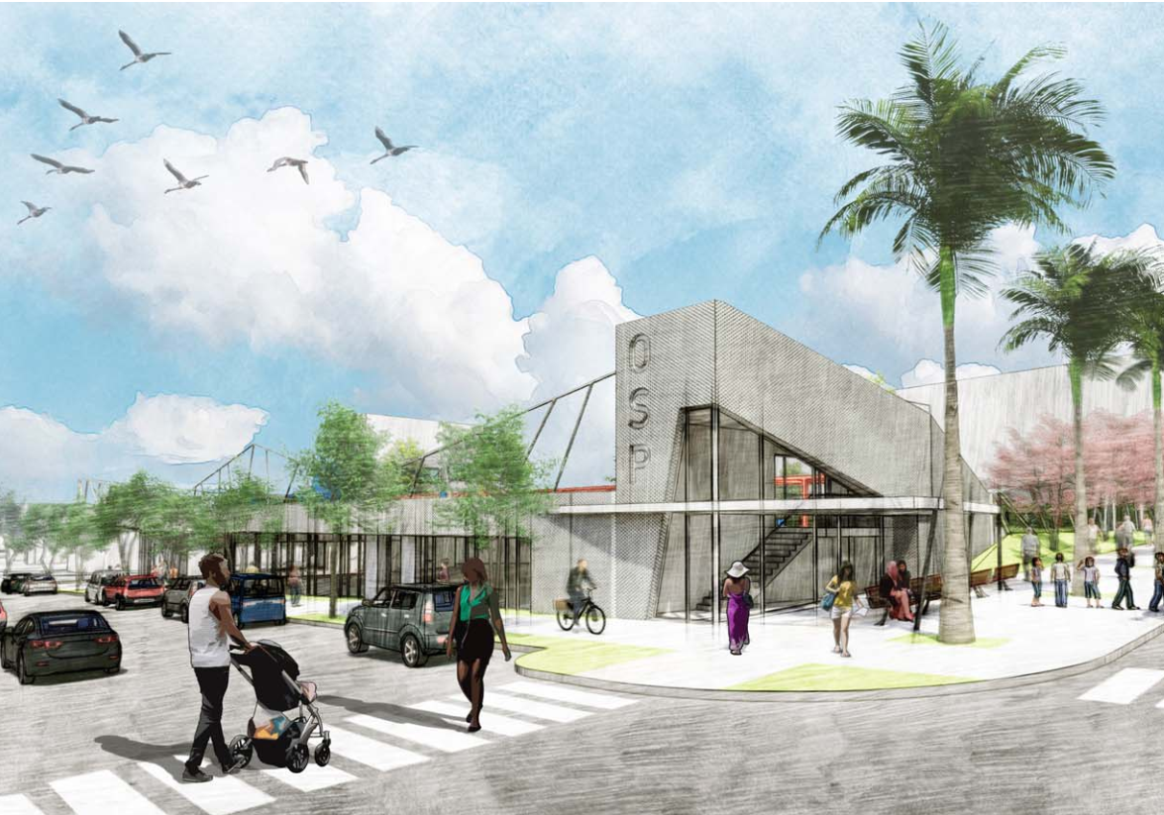
Thank you for your time!
Submit your additional comments to:
revitalizersp@hacla.org or
Zoe Kranemann, Development Officer,
Housing Authority of the City of Los Angeles, 2600 Wilshire Boulevard, Los Angeles, California 90057

