Slide 1
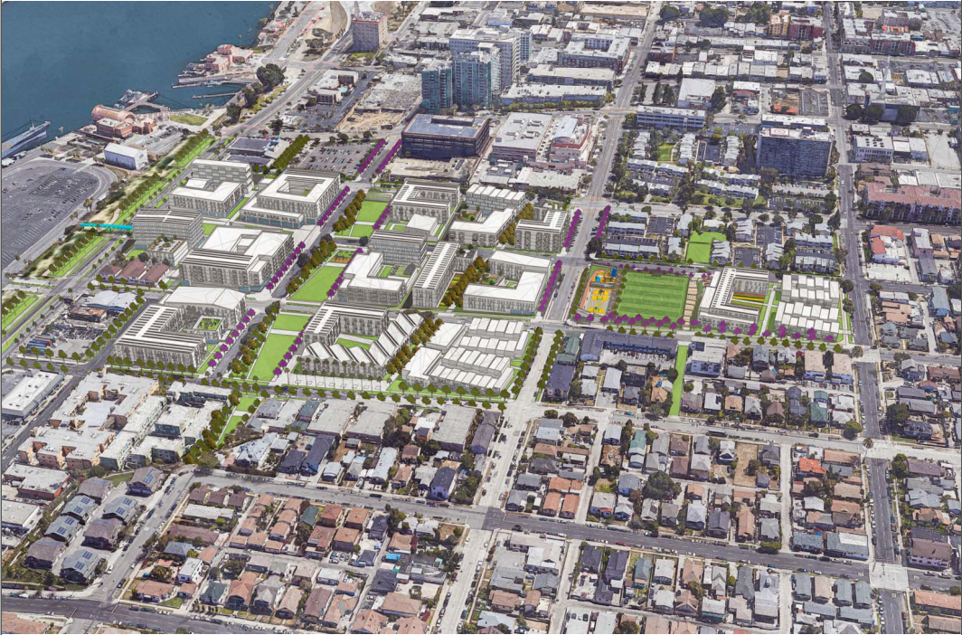
Housing Authority of the City of Los Angeles
& Housing + Community Investment Department
One San Pedro Specific Plan
Environmental Impact Report/Environmental Impact Statement
Virtual Scoping Meeting / February 6, 2021
Notes:
Jenny

Slide 2
Traducción del idioma español
Para traducción al español:
One San Pedro Specific Plan EIR/EIS Scoping Meeting
Notes:
Jenny

Slide 3
Housekeeping Items
Scoping Meeting will last approximately 60 minutes, including time for input.
While the presentation is being recorded, please submit all comments/questions on CEQA compliance in writing to ensure the adequacy of the record.
Please hold comments until the end of the presentation.
To provide input, type in the Chat or use the Raise Your Hand feature.
Please mute your microphone unless you are actively asking a question or providing feedback.
If you are joining by phone only, you can raise your hand by pressing *9 on your phone and use *6 to go unmute yourself.
Please identify yourself and your organization prior to asking a question or making a comment.
Technical issues? Use the Chat box to communicate with us.
One San Pedro Specific Plan EIR/EIS Scoping Meeting
Notes:
Jenny
Please hold all questions and comments until the end of the presentation. Copy of the presentation is available on the website. To ensure the adequacy of the record, we prefer all comments either in writing here on this forum or to our email address, both of which will be provided on a slide at the end of the presentation.

Slide 4
Using Zoom
Button for muting microphone located at bottom left of Zoom window
Use Chat button at bottom center of window to enter comments
Use the Raise Your Hand button by clicking Participants at the bottom of the screen. A new window will appear on the right side of the screen and the raise your hand button is located at the bottom of that window
One San Pedro Specific Plan EIR/EIS Scoping Meeting
Notes:
Jenny

Slide 5
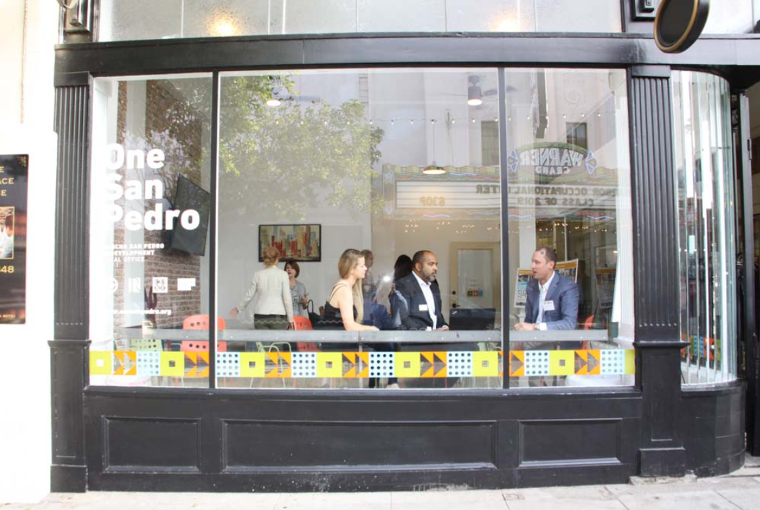
Meeting Agenda
Purpose of the Scoping Meeting
Introductions
Project team
Project Overview
Description of the One San Pedro Specific Plan
Project construction timeline
Environmental Review
Scope and Schedule of the Joint Environmental Impact Report (EIR)/Environmental Impact Statement (EIS)
Comments/Input
Above: Scene from the grand opening of the One San Pedro office in downtown San Pedro in June 2019.
2/6/2021
One San Pedro Specific Plan EIR/EIS Scoping Meeting
5
Notes:
Jenny

Slide 6
Purpose of the Scoping Meeting
Inform the community and affected agencies about the project
Describe the timeline and future opportunities for community input
Gather input from stakeholders about the topics covered in the EIR/EIS
Notes:
Jenny

Slide 7
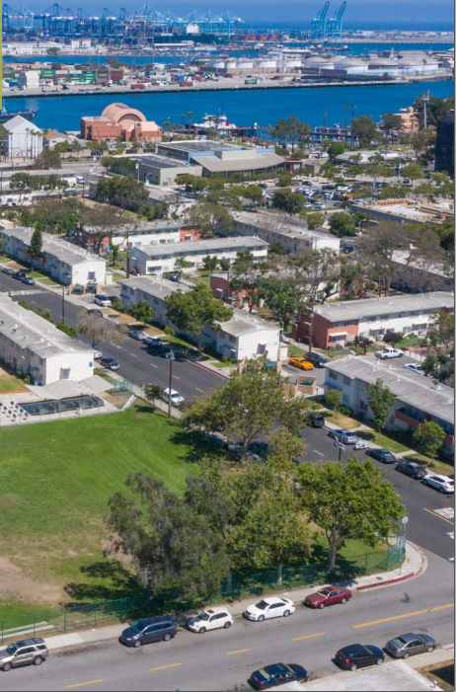
Introductions
Housing Authority of the City of Los Angeles
Jenny Scanlin
Jessica Frazier
Los Angeles Housing + Community Investment Department
Jinderpal Singh Bhandal
One San Pedro Collaborative
Alexa Washburn
Brian Ulaszewski
Rincon Consultants
Danielle Griffith
Deanna Hansen
Notes:
Jenny
Describe how/why all these groups are involved and their roles

Slide 8
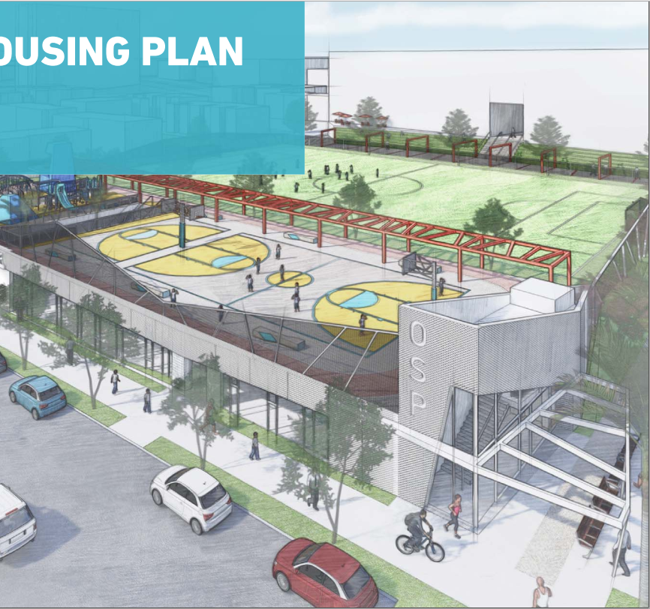
Project Overview
Notes:
Alexa

Slide 9
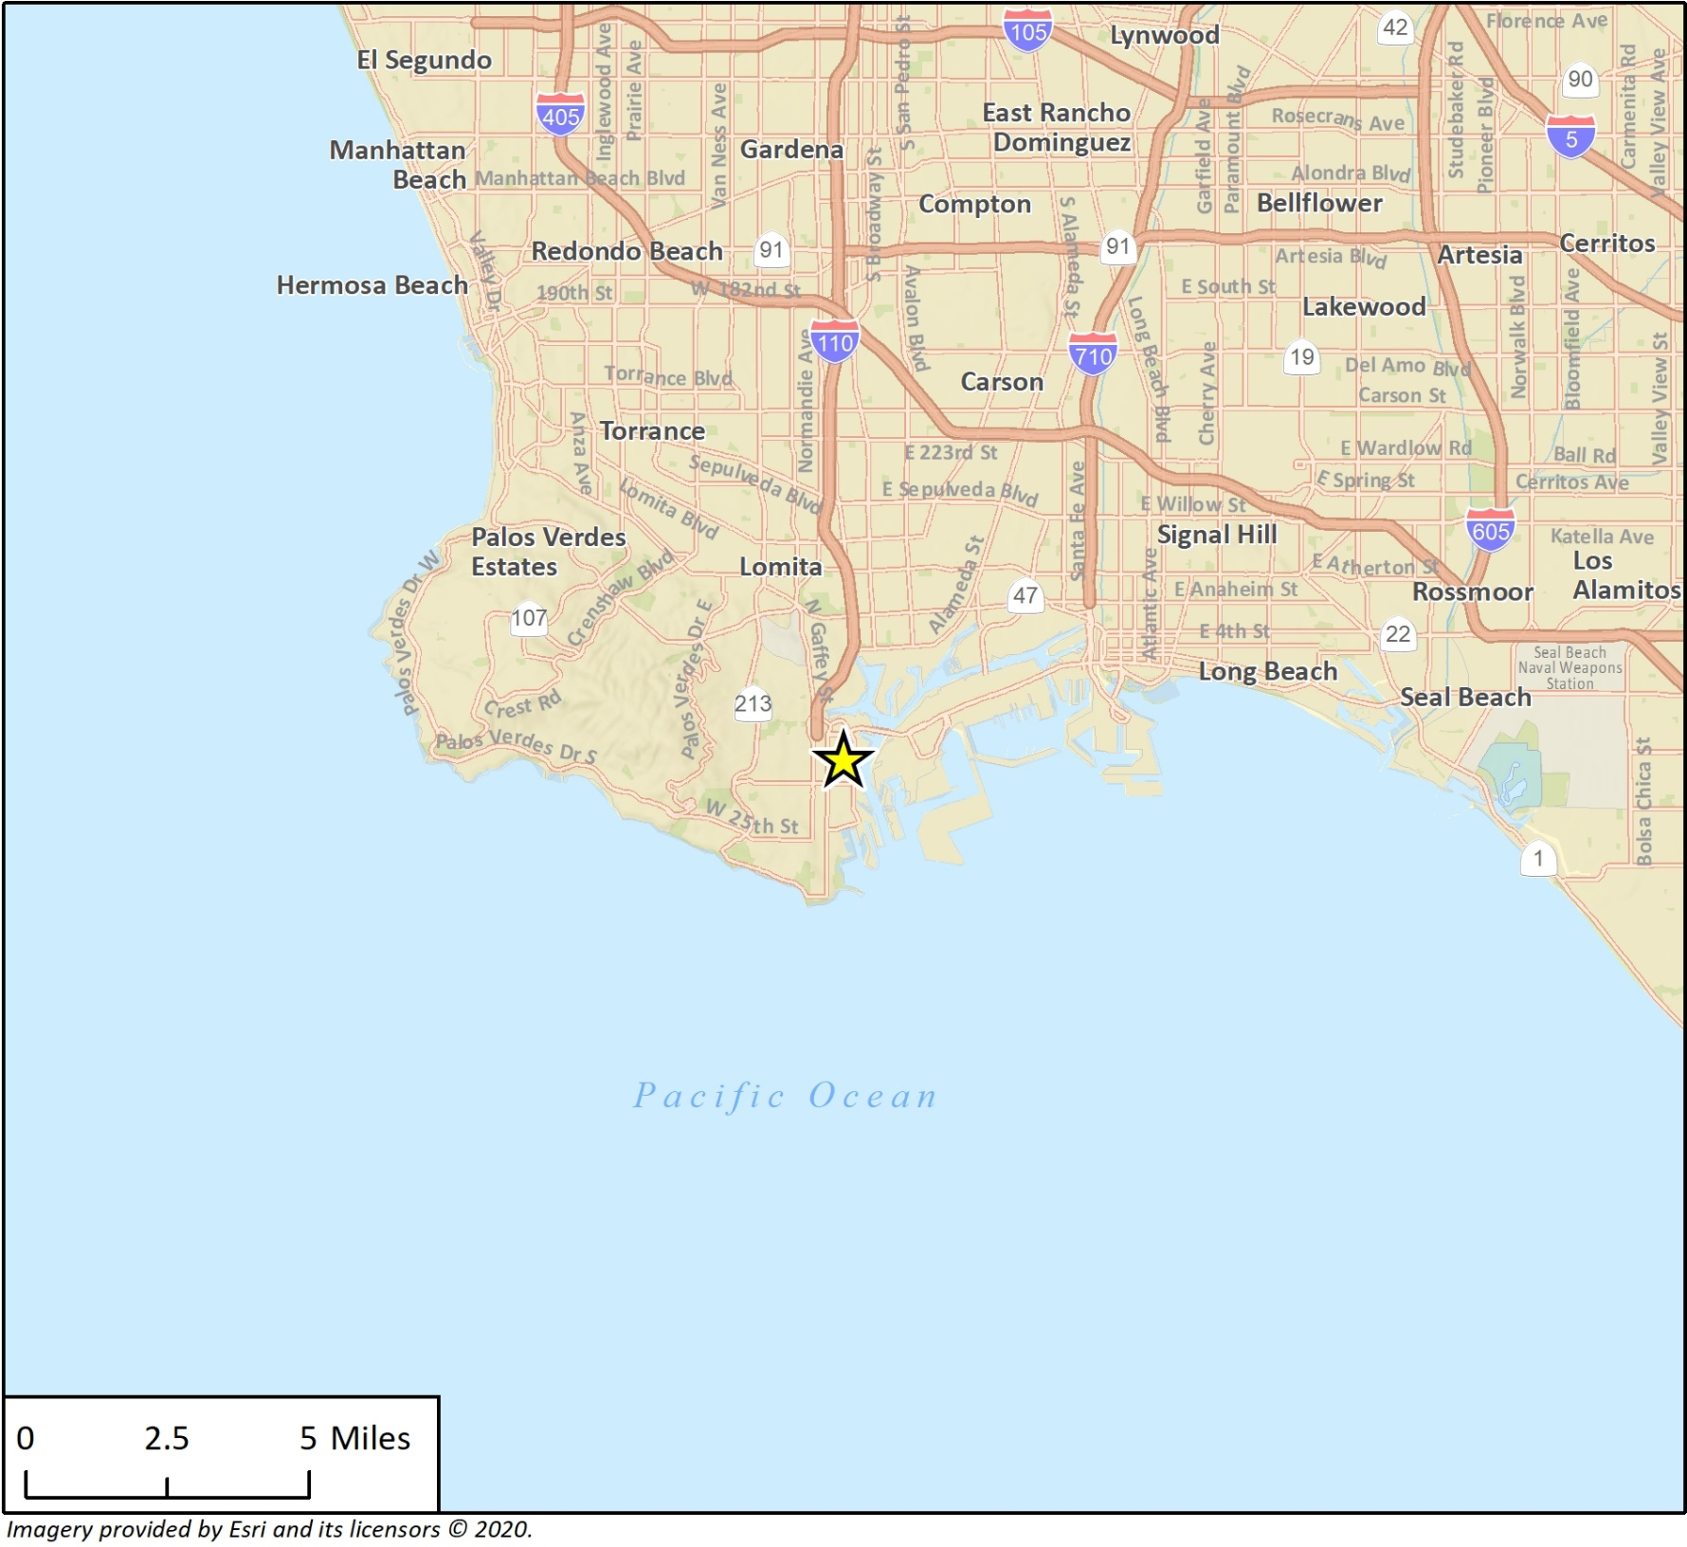
Project Location
2/6/2021
One San Pedro Specific Plan EIR/EIS Scoping Meeting
9
Notes:
Alexa

Slide 10
What is a Specific Plan?
A Specific Plan is a planning document that applies to a selected geographical area and contains a custom set of rules and land use regulations.
Specific Plans implement the goals and policies of the City’s General Plan for a focused area of the city, with additional standards that go beyond what the underlying zoning would normally regulate.
2/6/2021
One San Pedro Specific Plan EIR/EIS Scoping Meeting
10
Notes:
Alexa

Slide 11
One San Pedro Specific Plan
Purpose: Improve the physical condition of the Rancho San Pedro community and increase housing stock and amenities for residents.
Benefits:
Improve housing conditions for existing residents
Increase affordable and senior housing availability
Expand community amenities and open space
Improve multi-modal mobility facilities
Create a vibrant, mixed-use community
2/6/2021
One San Pedro Specific Plan EIR/EIS Scoping Meeting
11
Notes:
Alexa

Slide 12
Specific Plan Chapters
Introduction
Current Conditions
Research & Engagement
Development Plan
Development Standards
Mobility
Open Space
Design Guidelines
Infrastructure
Administration & Implementation
Notes:
Alexa
Although appearance, organization and content of an SP is unique and tailored for a specific location, Government Code requires certain sections/chapters of a SP:
Development Plan – Location and description of permitted land uses (also any prohibited, conditionally, temporary, or accessory uses) including a detailed master planning for Waterman Gardens site, the school site and the adjacent underutilized commercial center
Development Standards - Provides standards for how bldgs in the SP area can be developed including required setbacks, parking requirements, landscaping, FAR, densities – how many units or square footage are allowed on a site, etc.
Mobility Plan – Addresses both vehicular and non-vehicular mobility; established and planned roadways as well as walking, biking and transit opportunities to ensure connectivity and mobility.
Open Space
Design Guildelines - Provides guidelines to enhance architectural style of existing and future bldgs. Guidelines for design features such as roof lines, window treatments, entryways, bldg materials & colors, lighting, signage, streetscape
Infrastructure Plan – Provides info about utilities and public services including water, sewer, energy, police and fire and other services necessary to redevelop and serve the area.
Administration & Implementation – Includes necessary steps to implement the SP including a toolbox financing mechanisms:
Identification and prioritization of key opportunity sites;
Recommended timing of public improvements;
Identification of incentives necessary to attract desired development/land uses

Slide 13
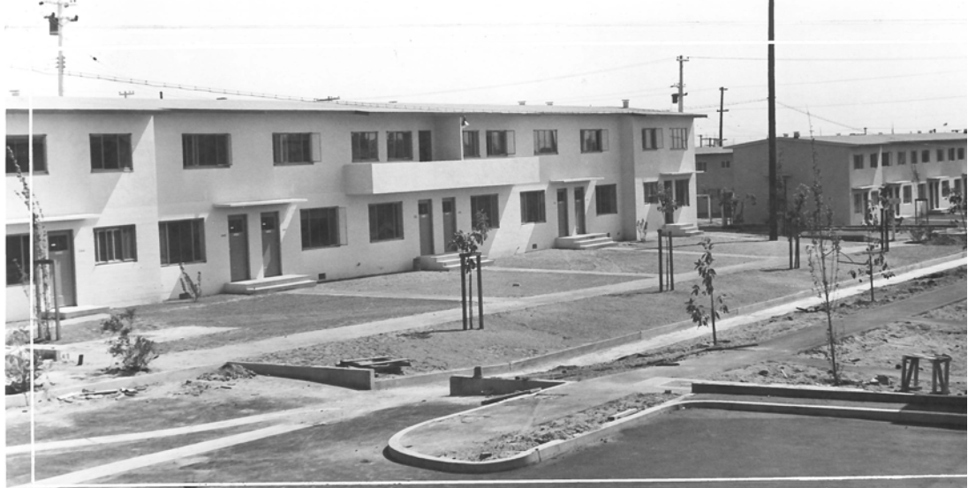
Project Components
Phased demolition of the 479-unit public housing complex and replacement with new housing, local-serving commercial uses, and amenities
Construction of:
Up to 1,390 multi-family residential units (mix of affordable and market-rate units, including rentals and homes for purchase)
85,000 square feet of residential amenities and services
49,000 square feet of commercial/retail space (e.g., grocery, pharmacy, laundromat, etc.)
New open space, bicycle, transit, and pedestrian amenities
Above: Historic picture of Rancho San Pedro after it was constructed in 1942.
2/6/2021
One San Pedro Specific Plan EIR/EIS Scoping Meeting
13
Notes:
Alexa

Slide 14
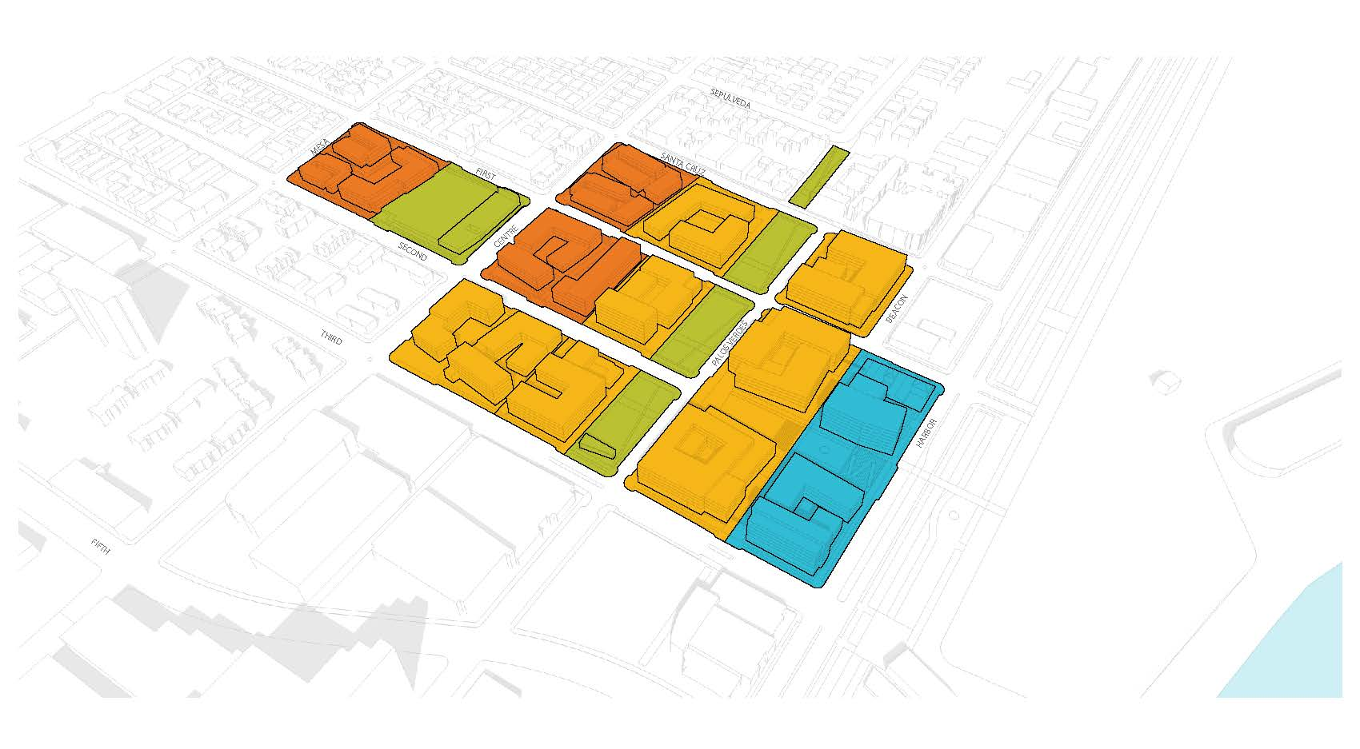
Land Use Districts
Notes:
Alexa
Describe the open space areas, mobility and other site improvements

Slide 15
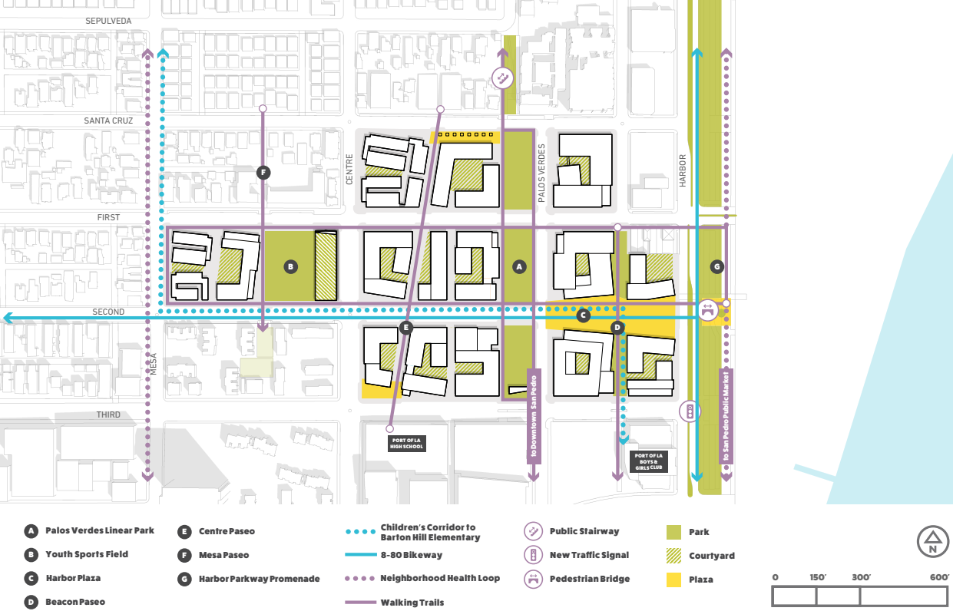
Conceptual Site Plan
Notes:
Alexa
Describe the land uses, building heights, construction phasing, open space areas, other site improvements

Slide 16
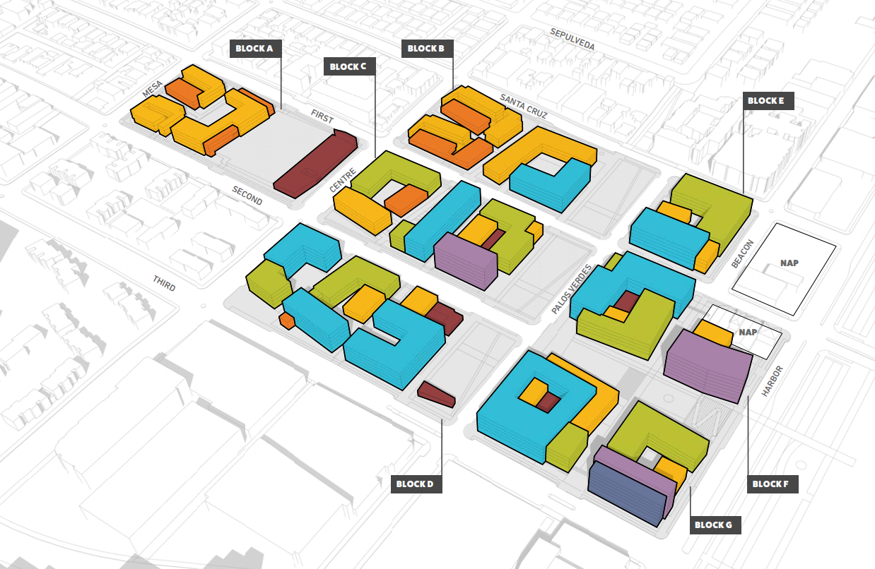
Building Heights
Notes:
Alexa
Describe the land uses, building heights, construction phasing, open space areas, other site improvements

Slide 17
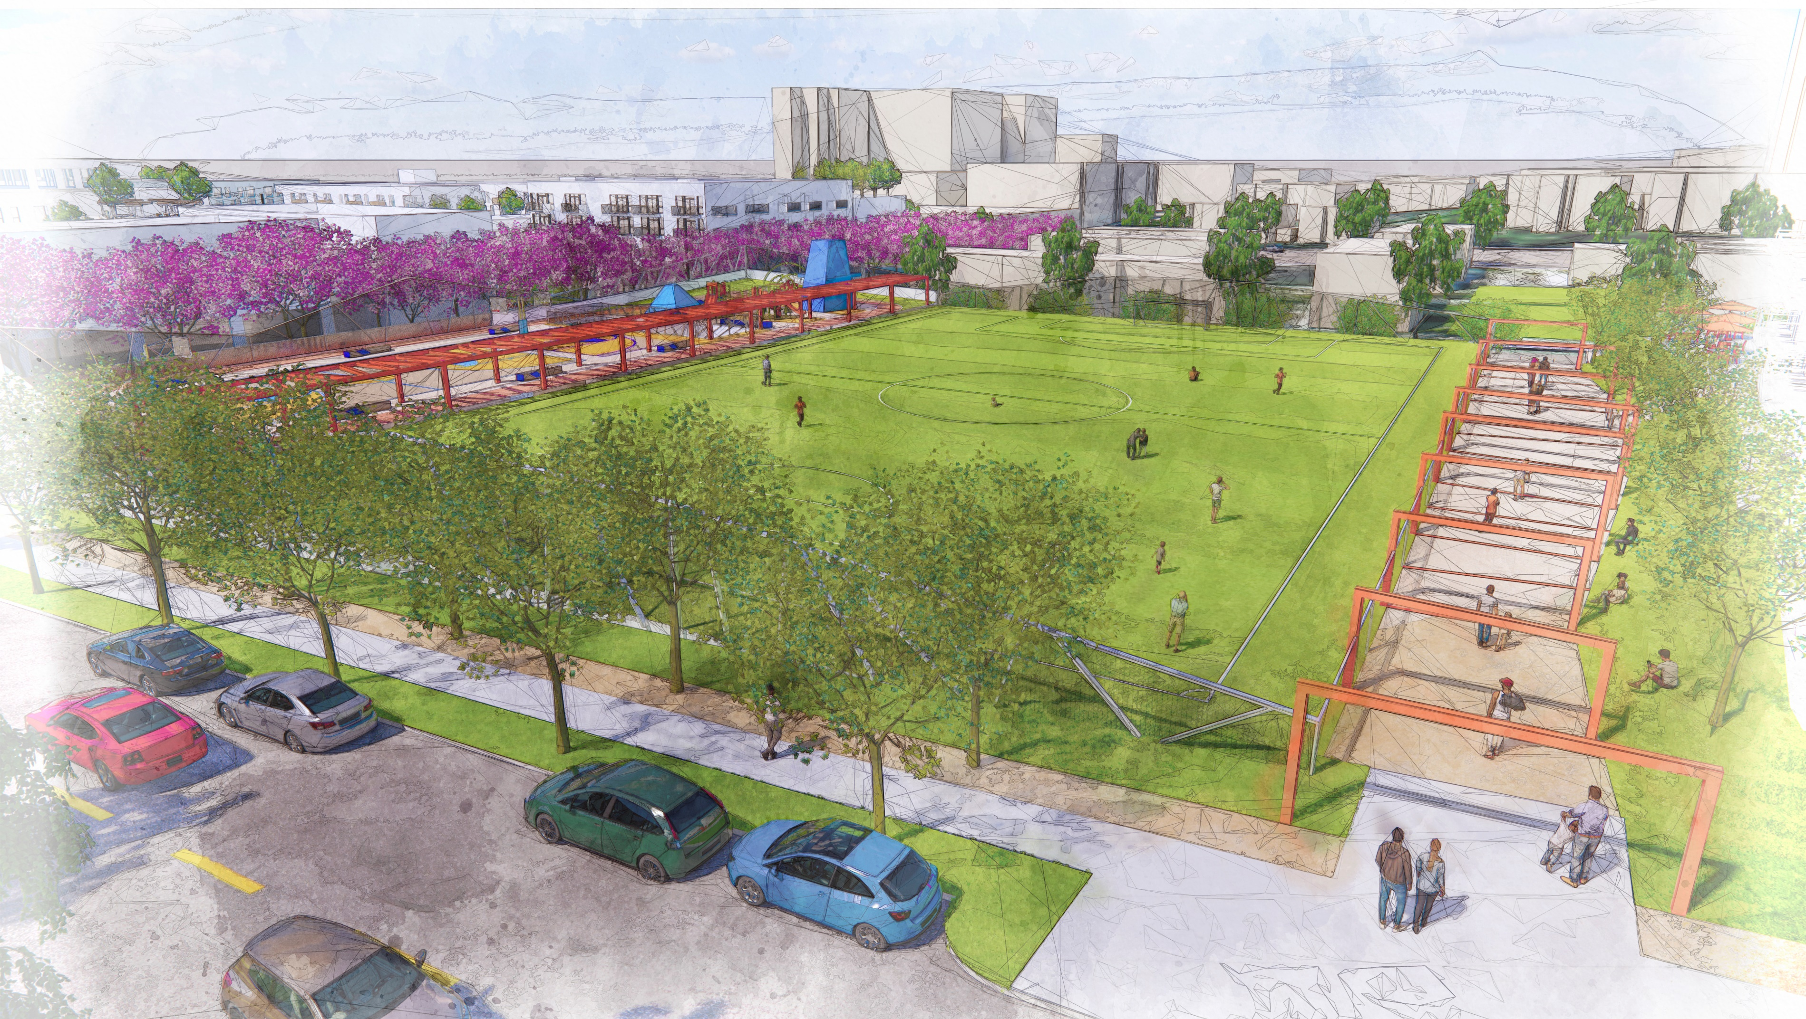
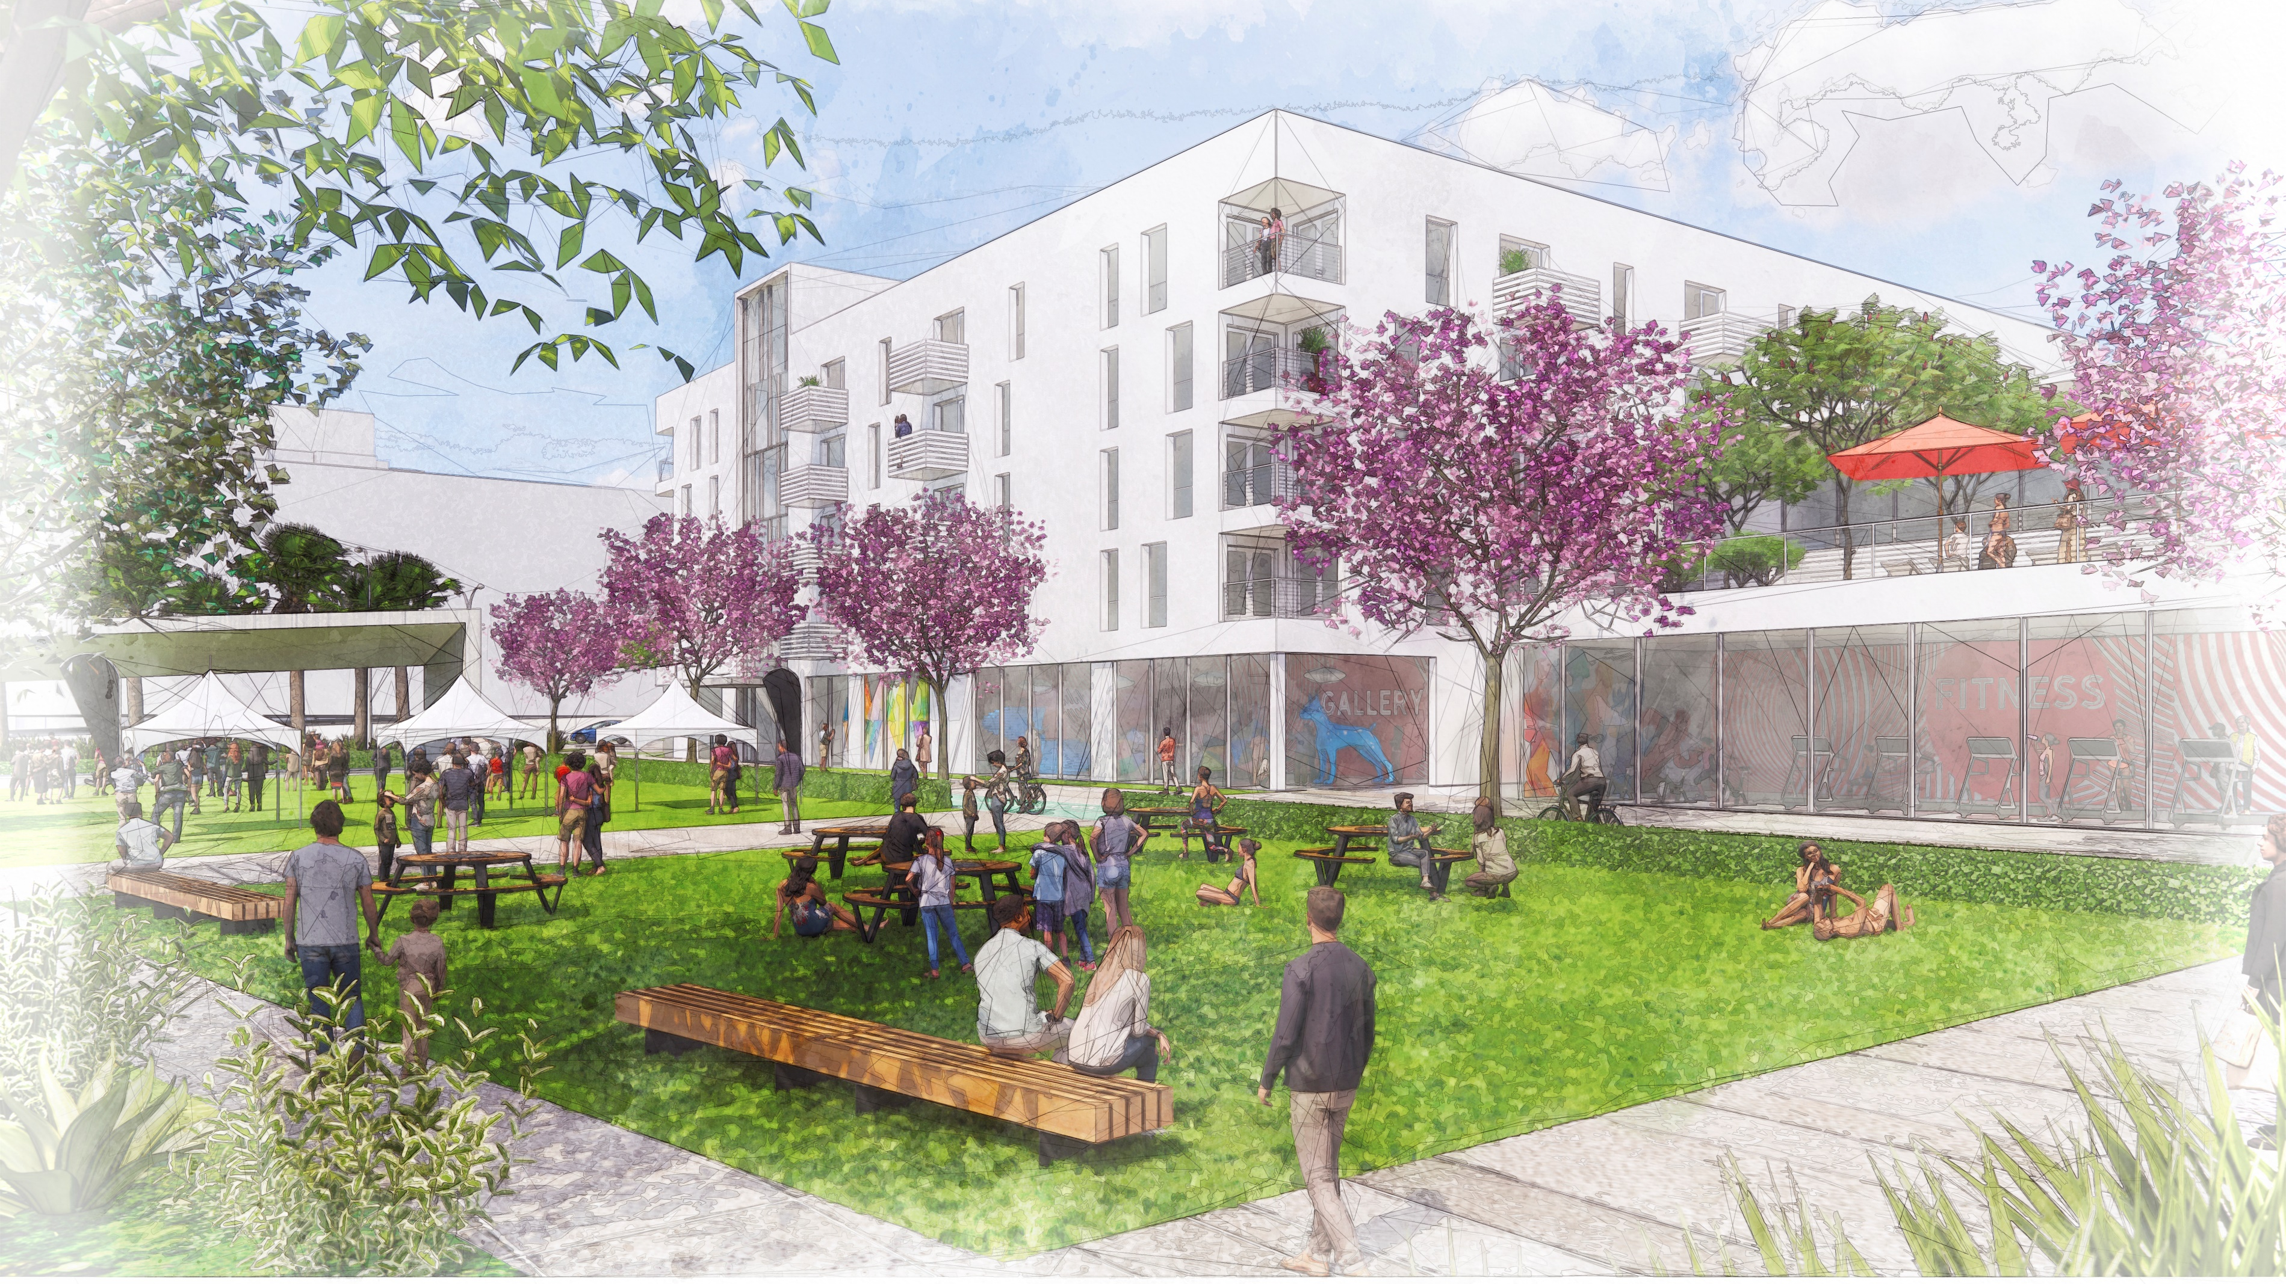
Open Space Renderings
Notes:
Alexa
Describe the open space areas, mobility and other site improvements

Slide 18
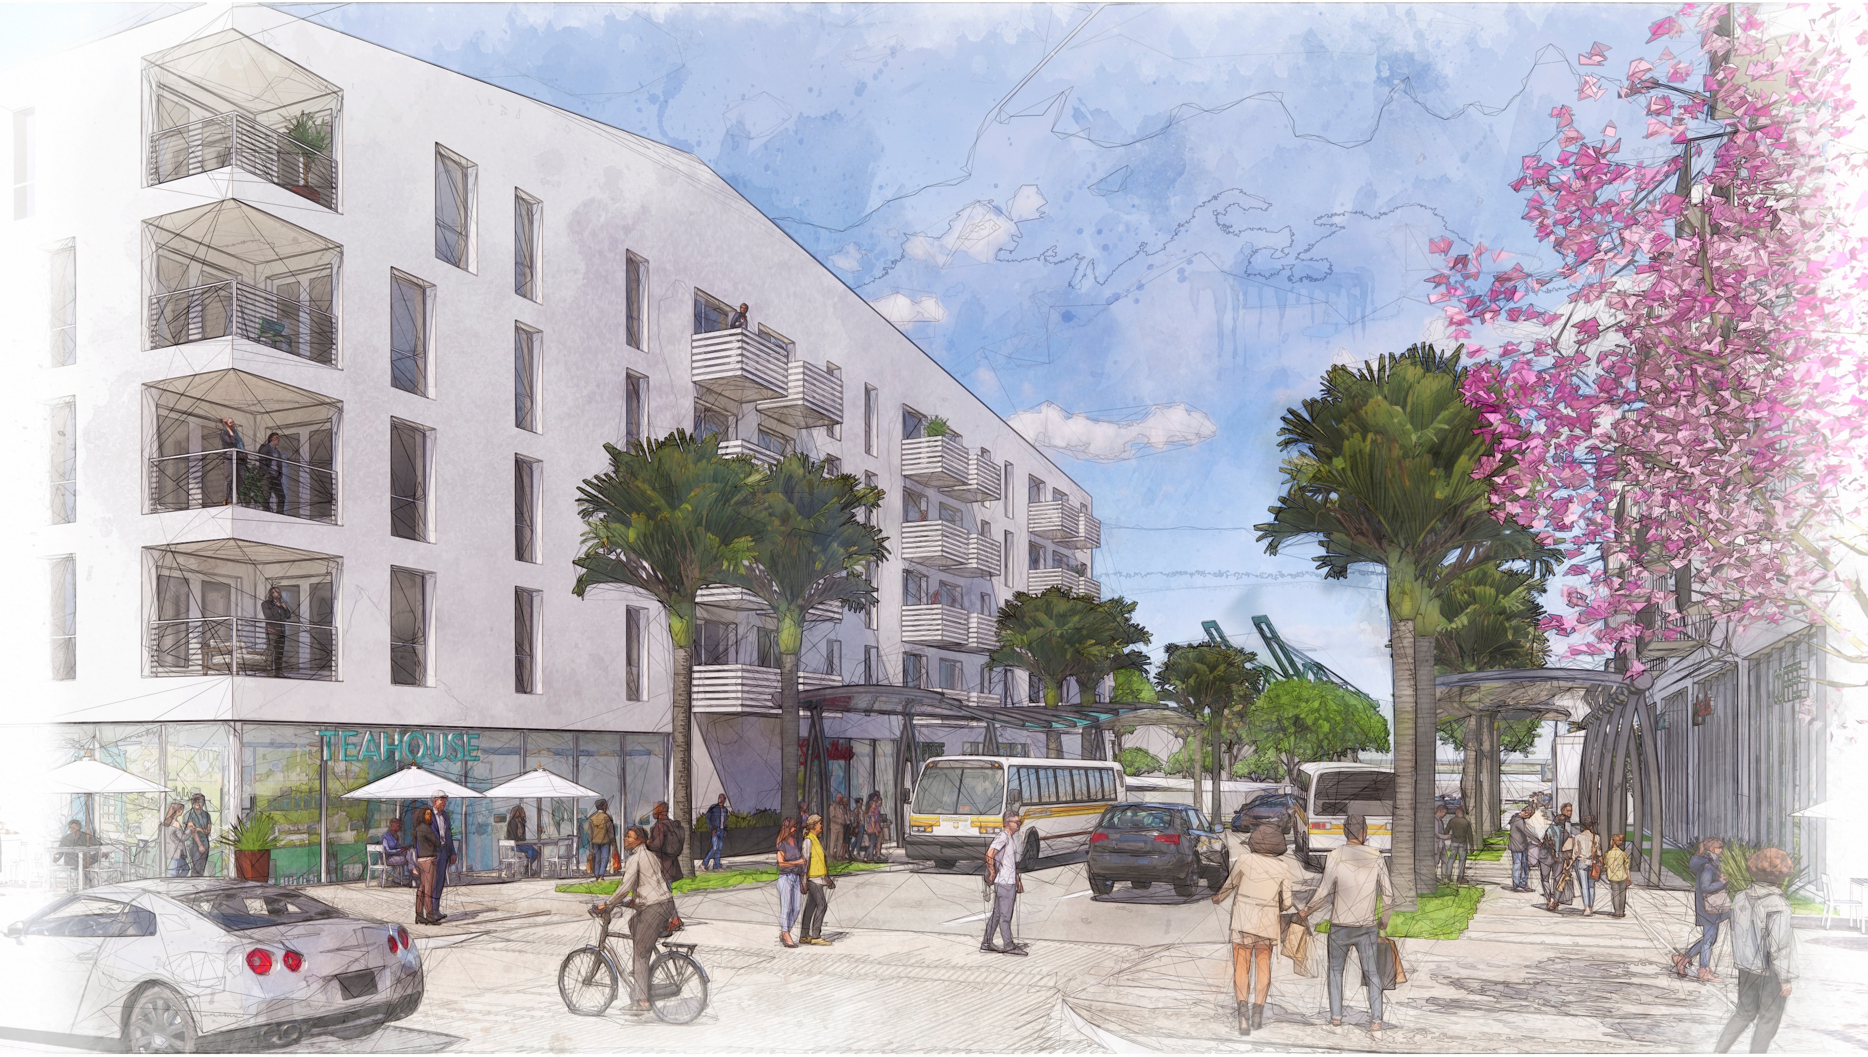
Mobility Renderings
Notes:
Alexa
Describe the open space areas, mobility and other site improvements

Slide 19
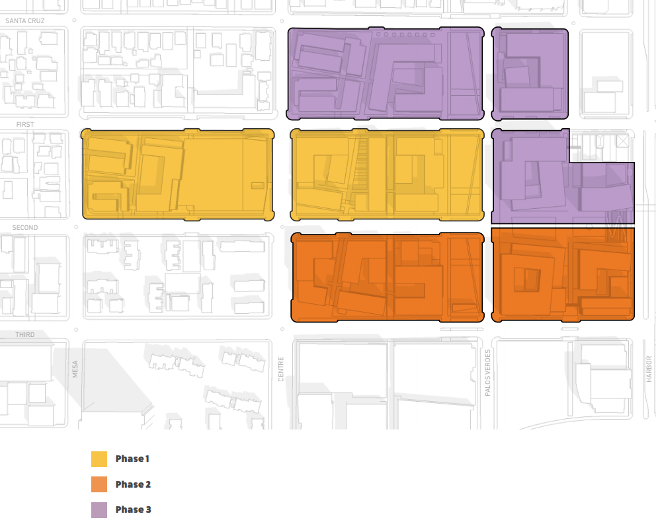
Anticipated Project Construction Timeline
Phased construction (3 main phases) beginning in 2024 and ending in 2037 (15 total years)
Opening year for Phase I buildings anticipated in 2025
Initial phases focus on replacement of aging rental housing
Later phases involve development of commercial and community amenity uses and homeownership units
2/6/2021
One San Pedro Specific Plan EIR/EIS Scoping Meeting
19
Notes:
Alexa
Stage I: Focus on Replacing Rancho Units and Existing Amenities (west) Stage I redevelops all of the existing Rancho amenities, while expediting the replacement of existing units. While the first phase is located at the current site of the Social Hall and Sports Field to limit disruption, some temporary relocation of Rancho residents, amenities, and functions will be necessary. This portion of redevelopment is generally the least intensive of the three, relating to the Barton Hill neighborhood to the north and west, and Verdes Del Oriente Apartments to the south. The Phase 1 development site will be adjacent to a cluster of existing Rancho buildings, potentially impacting current residents. The development of the western most Block A also requires construction hauling along 1st Street to Harbor Boulevard, through portions of Rancho San Pedro still occupied by residents. While future phases will also not require such impacts from construction and hauling, efforts will be made to mitigate impacts from these early phases.
Stage II: Focus on Replacing Rancho Units, Expanding Housing Opportunities, and Adding Health and Wellness Amenities (South) Stage II focuses on replacing a majority of Rancho units, while introducing new housing opportunities including homeownership units. New amenities emphasize health and wellness (i.e. health clinic, wellness center, grocer/pharmacy, outdoor fitness center). Stage I developments provided new homes for the majority of Rancho residents living in Stage II, limiting construction impacts on Rancho residents remaining in the current buildings. The construction hauling route is located entirely on 3rd Street and Harbor Boulevard, limiting traffic impacts on residents, but attention should be paid to youth attending the Port of LA Boys and Girls Club, and Port of LA High School.
Stage III: Focus on Replacing Remaining Rancho Units, Expanding Housing Opportunities and Local Economic Opportunities (North) The final replacement units will be constructed in Stage III. While distributed throughout the site, the 80-20 buildings are relatively contiguous to streamline financing and construction. The remaining portion of Stage III is the development of the remaining homeownership units located in the area adjacent to the Barton Hill neighborhood. While construction of these phases are located across the street from existing Barton Hill homes and recent One San Pedro buildings, the construction hauling route will be located along 1st Street to Harbor Boulevard, limiting impacts on residents. The northern portion of amenities like the Palos Verdes linear park, retail center, and paseos will be completed during Stage III, with connections north of Santa Cruz Street, tying all surrounding neighborhoods together into One San Pedro.

Slide 20
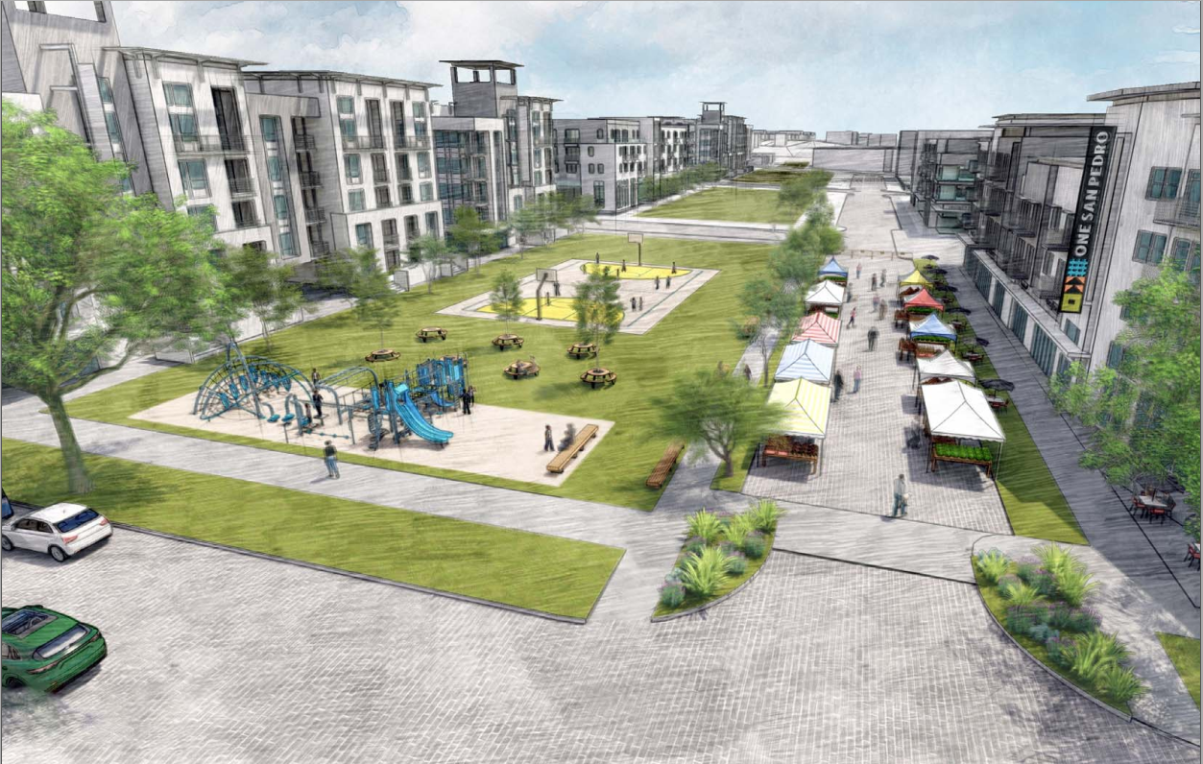
Environmental Review Process
Notes:
Danielle

Slide 21
Purpose of the Environmental Review Process
Disclose the significant environmental impacts of a proposed project to decisionmakers and the public
Identify ways to avoid or reduce environmental impacts
Prevent environmental damage by requiring implementation of a feasible alternative or mitigation measures
Foster interagency coordination in project review
Enhance public participation in the planning process
2/6/2021
One San Pedro Specific Plan EIR/EIS Scoping Meeting
21
Notes:
Danielle

Slide 22
Project Environmental Review Requirements and Roles
Two types of environmental review required:
California Environmental Quality Act (CEQA) - Statewide environmental protection policy. Required because the project would need discretionary approvals from HACLA and the City of Los Angeles, including but not limited to approval of the Specific Plan, a zone change, and General Plan Amendment
National Environmental Policy Act (NEPA) - U.S. environmental protection law. Required because the project involves Federal funding from the United States Department of Housing and Urban Development (HUD)
Lead Agencies responsible for environmental review:
HACLA is responsible for the CEQA portion of environmental review
HCID acts as the responsible entity on behalf of HUD for the NEPA portion of environmental review
Level of review required:
Project may potentially have significant impacts on a range of environmental issues. Therefore, preparation of an EIR under CEQA and EIS under NEPA is proceeding (most in-depth level of environmental review under these policies)
2/6/2021
One San Pedro Specific Plan EIR/EIS Scoping Meeting
22
Notes:
Danielle

Slide 23
Environmental Review Process
We are
here
HACLA Circulates Notice of Preparation (30-day minimum)
Prepare Draft EIR/EIS Document
Circulate Notice of Availability of Draft EIR/EIS
Public Review Period (45-day minimum)
Prepare Final EIR/EIS and Mitigation Monitoring and Reporting Program
Lead Agencies Make Decisions on the EIR/EIS
2/6/2021
One San Pedro Specific Plan EIR/EIS Scoping Meeting
Notes:
Danielle

Slide 24
Public Scoping Meetings
Two opportunities for stakeholders to provide feedback at public scoping meetings
CEQA Public Scoping Meeting (this meeting): February 6, 2021
NEPA Public Scoping Meeting: anticipated in April 2021, date to be determined
Meeting information will be provided in a subsequent notice
2/6/2021
One San Pedro Specific Plan EIR/EIS Scoping Meeting
24
Notes:
Danielle

Slide 25
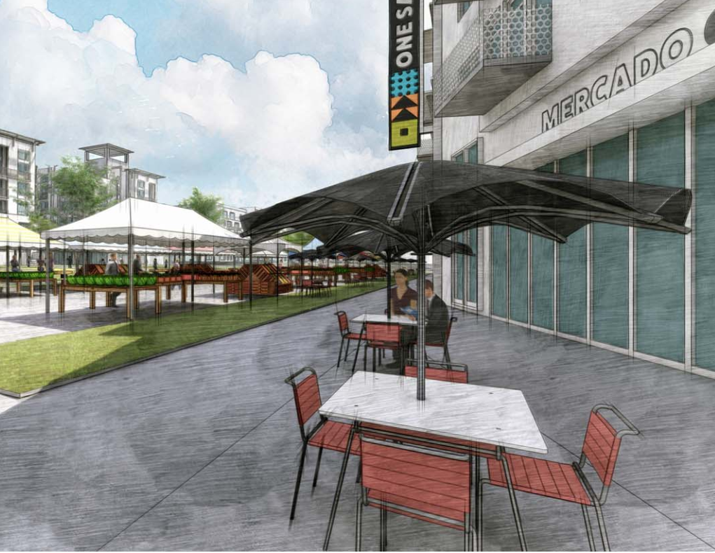
EIR/EIS Scope and Schedule
Notes:
This next section will describe the EIR/EIS Approach, Scope and Anticipated Schedule

Slide 26
Required contents of the EIR/EIS
Project description
Environmental setting
Discussion of environmental impact areas
Growth-inducing impacts of the project
Significant and unavoidable impacts
Mitigation measures to minimize impacts
Discussion of alternatives
NEPA including Environmental Justice
2/6/2021
One San Pedro Specific Plan EIR/EIS Scoping Meeting
26

Slide 27
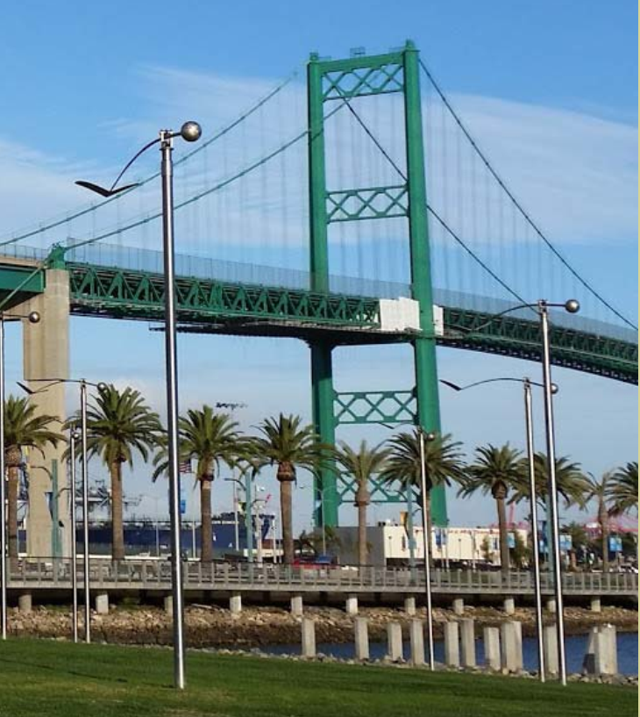
Environmental Topics to be Analyzed in the EIR/EIS
Aesthetics Air Quality Biological Resources Cultural Resources Energy Environmental Justice Geology/Soils Greenhouse Gas Emissions Hazards/Hazardous Materials
Hydrology/Water Quality Land Use/Planning Noise Population/Housing Public Services Recreation Transportation Tribal Cultural Resources Utilities/Service Systems
Above: San Pedro waterfront and Vincent Thomas Bridge.
2/6/2021
One San Pedro Specific Plan EIR/EIS Scoping Meeting
27
Notes:
These are the environmental topics that will be analyzed for the One San Pedro project. The purpose of this meeting is to collect public comments and input on any of these topics, so please let us know if you have any concerns related to these topics or if there are other issues that you think should be considered.

Slide 28
Anticipated Environmental Review Schedule
January 13, 2021: NOP mailed and posted online
February 6, 2021: Public Scoping Meeting for CEQA
February 12, 2021: Last day to submit CEQA-related comments on the Project
April 2021: Anticipated Public Scoping Meeting for NEPA
April/May 2021: Anticipated close of comment period for NEPA-related comments
January 2021 – Summer 2021: Specific Plan and Draft EIR/EIS development
Fall 2021/Winter 2021: Development of Final EIR/EIS
Winter 2021/Spring 2022: Lead Agencies begin review and consider certification of the Final EIR/EIS
We are
here
2/6/2021
One San Pedro Specific Plan EIR/EIS Scoping Meeting
Notes:
Danielle

Slide 29
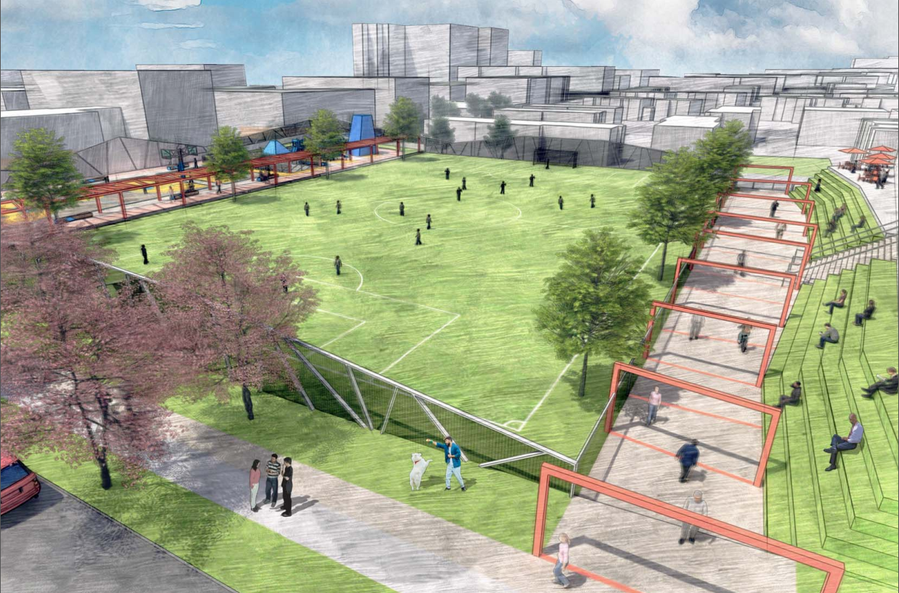
Comments
Comments Regarding the Scope of the EIR/EIS

Slide 30
Comments
2/6/2021
One San Pedro Specific Plan EIR/EIS Scoping Meeting
30
Notes:
Board for HACLA to record comments

Slide 31
Comments
2/6/2021
One San Pedro Specific Plan EIR/EIS Scoping Meeting
31
Notes:
Board for HACLA to record comments

Slide 32
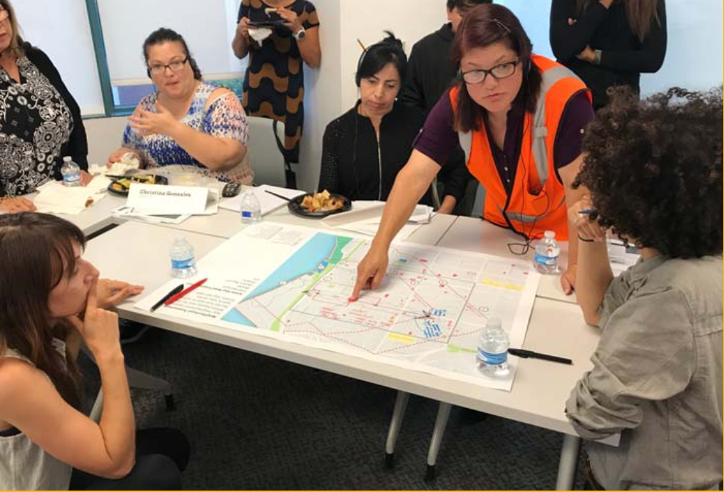
We welcome your comments!
Email your comments to jessica.frazier@hacla.org (reference “One San Pedro EIR/EIS” in the subject line)
Written comments can be sent to:
Jessica Frazier, Development Officer, Strategic Development Housing Authority of the City of Los Angeles 2600 Wilshire Boulevard, 3rd Floor Los Angeles, California 90057 (213) 252-4215
1/23/2021
One San Pedro Specific Plan EIR/EIS Scoping Meeting
32

Slide 33
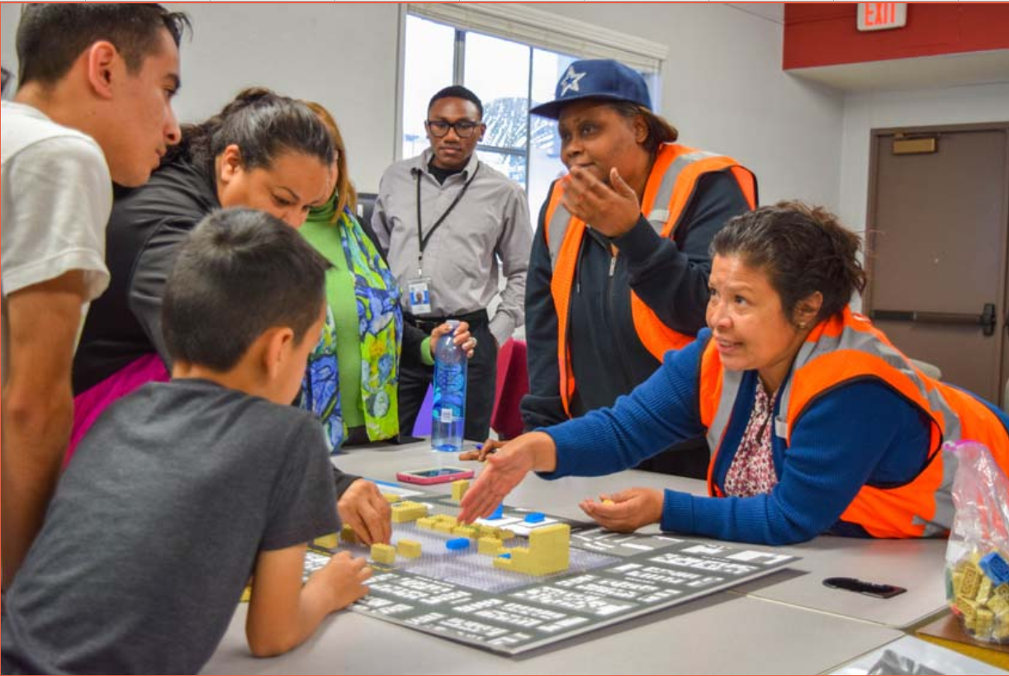
NEPA Scoping Meeting
In accordance with the federal NEPA requirements, a second virtual public scoping meeting will be held for the project in April. Meeting details will be provided in the upcoming weeks through a separate notice.
2/6/2021
One San Pedro Specific Plan EIR/EIS Scoping Meeting
33

Slide 34
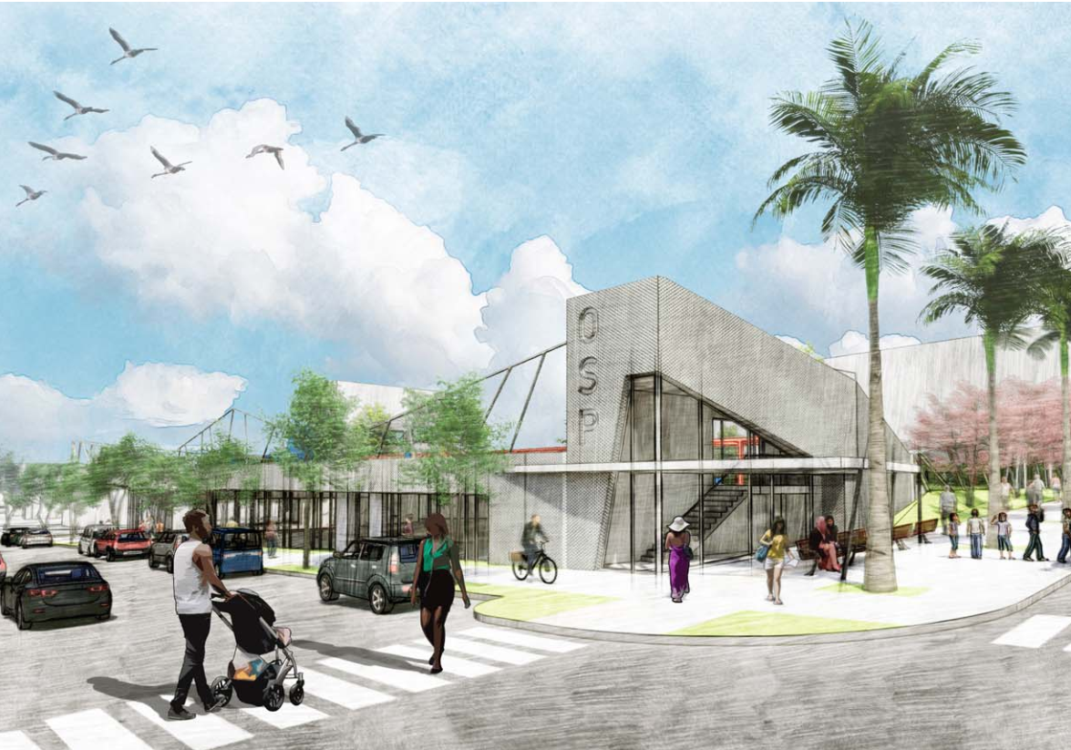
Thank you for your time!

